Slide 1
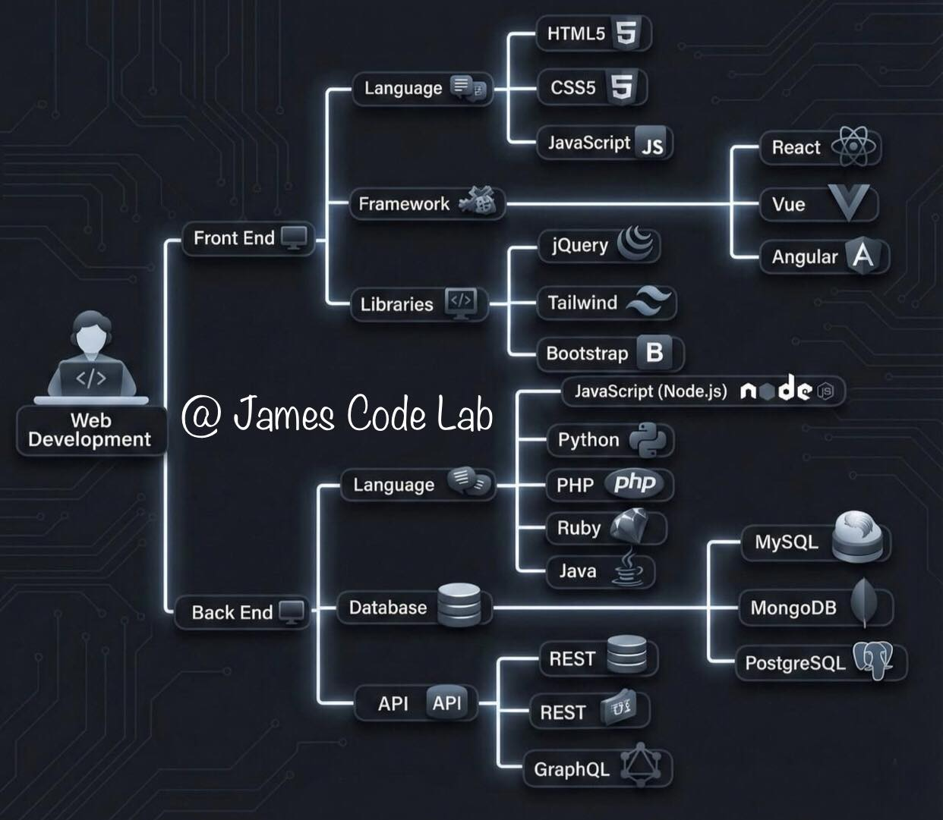
Building a website involves a lot of moving parts. Here is the simplest way to visualize the tech stack:
🎨 Front-End (What you see)
The Vibe: Visuals, Buttons, Layouts.
The Tech: HTML, CSS, JavaScript, React, Tailwind.
⚙️ Back-End (How it works)
The Vibe: Data, Logic, Security.
The Tech: Python, Node.js, SQL, MongoDB.
🚀 Full-Stack
The Vibe: The complete package. Handling the lifecycle from pixel to server.
Whether you prefer pixels or databases, there is a place for you in tech.

Slide 2
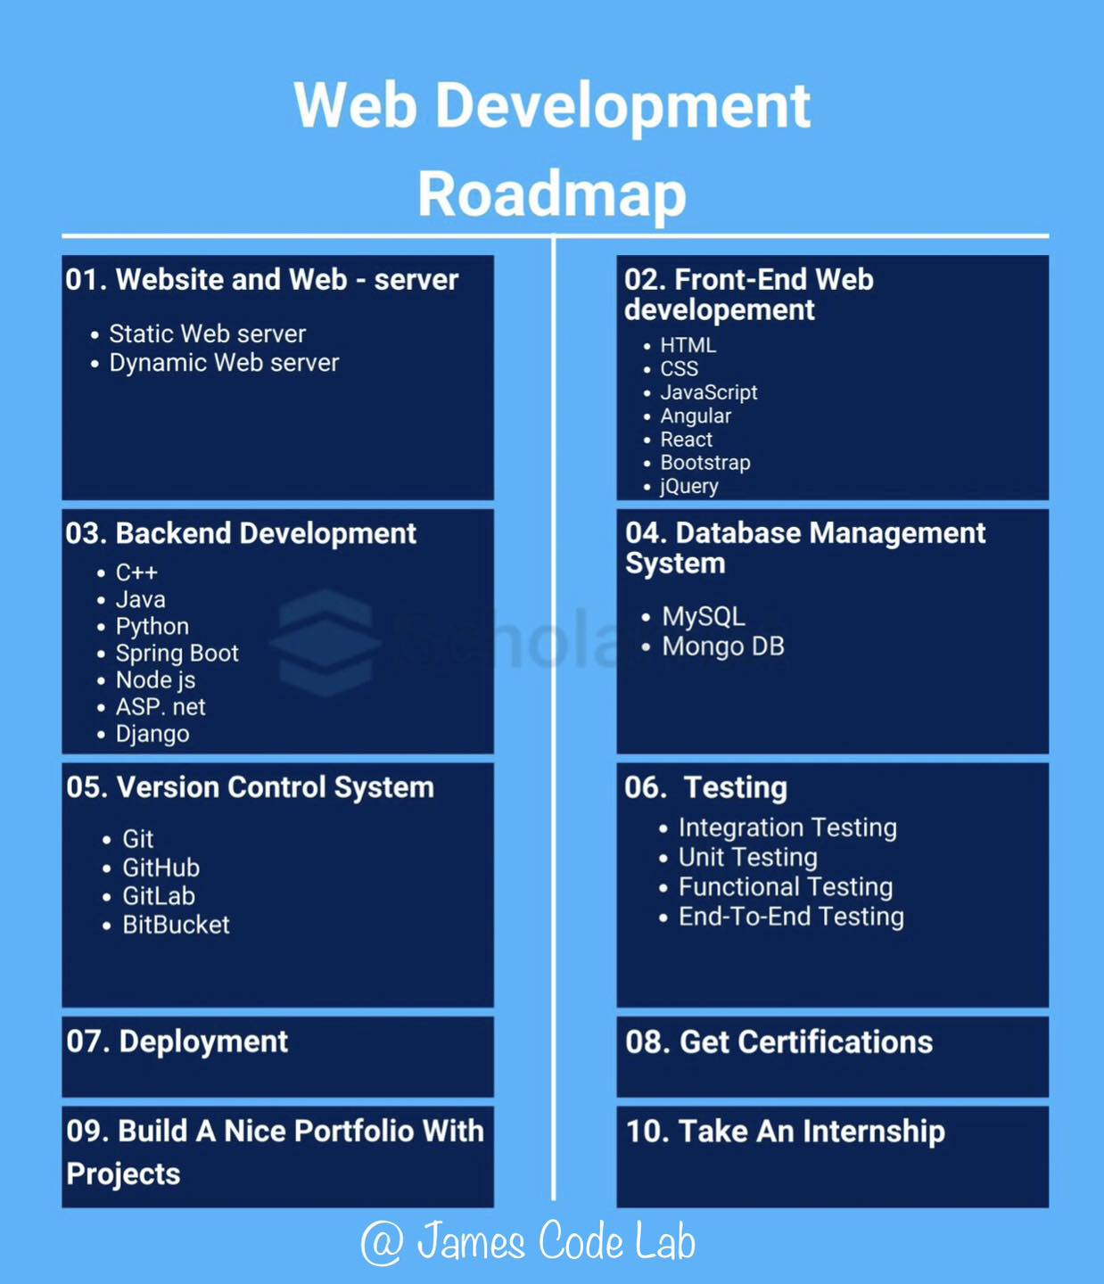
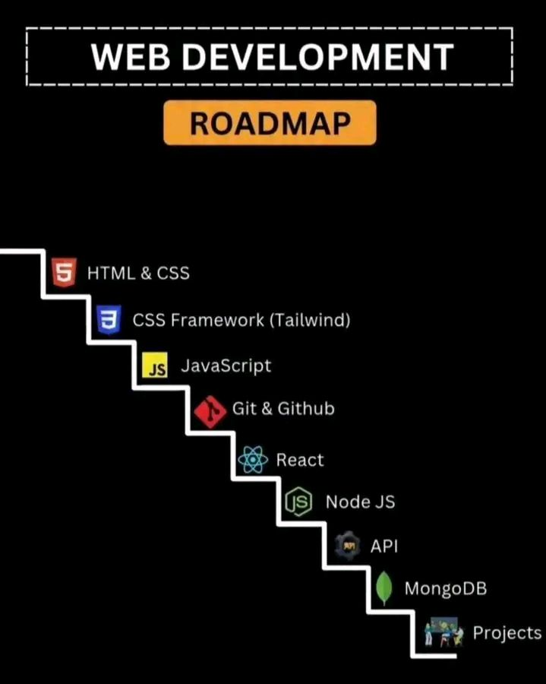
Notes:
Learning Web Development isn’t hard — following the wrong roadmap is. Most beginners struggle with: What to learn first Which tools to choose Frontend or Backend? This roadmap shows a clear step-by-step path: • Web & server fundamentals • Frontend (HTML, CSS, JavaScript, React, etc.) • Backend (Node.js, Python, Java, Django…) • Databases, Git & Testing • Deployment, Portfolio & Internship Key takeaway: More than technologies, sequence and consistency matter. With the right roadmap, progress becomes natural. Save this roadmap if you’re serious about becoming a Web Developer. Would you choose Frontend or Backend — and why? Drop your answer in the comments #WebDevelopment #Roadmap #LearnToCode #Developers #TechCareer #Programming #fblifestyle #code231
See less

Slide 3
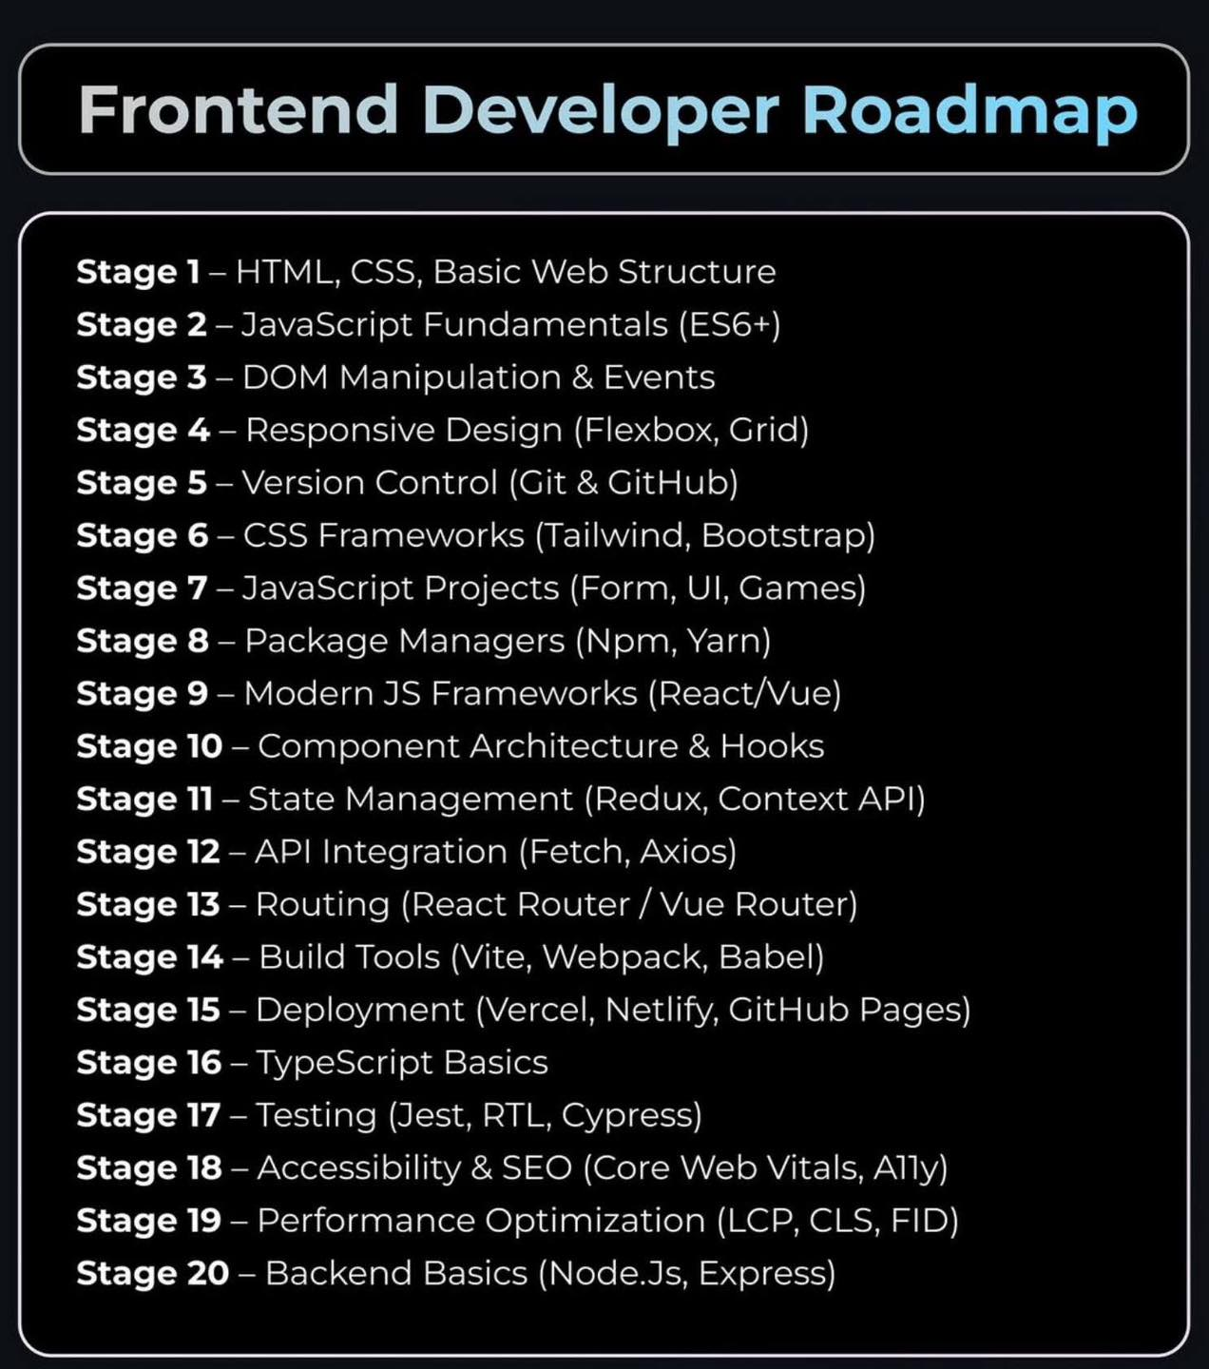
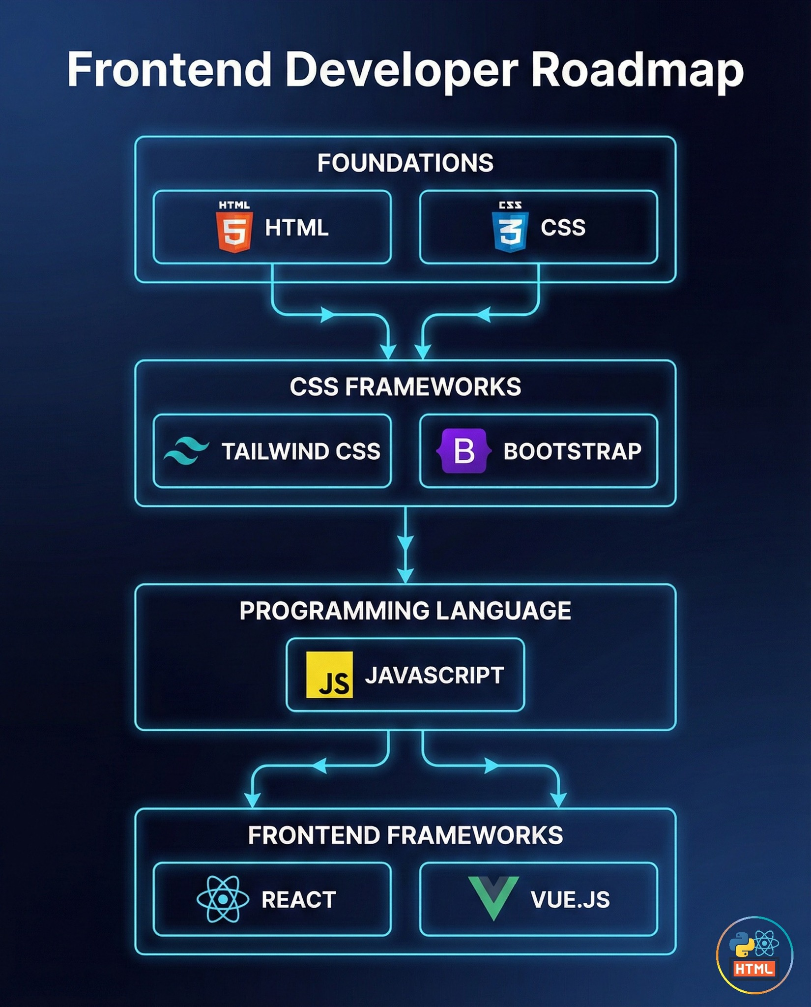

Slide 4

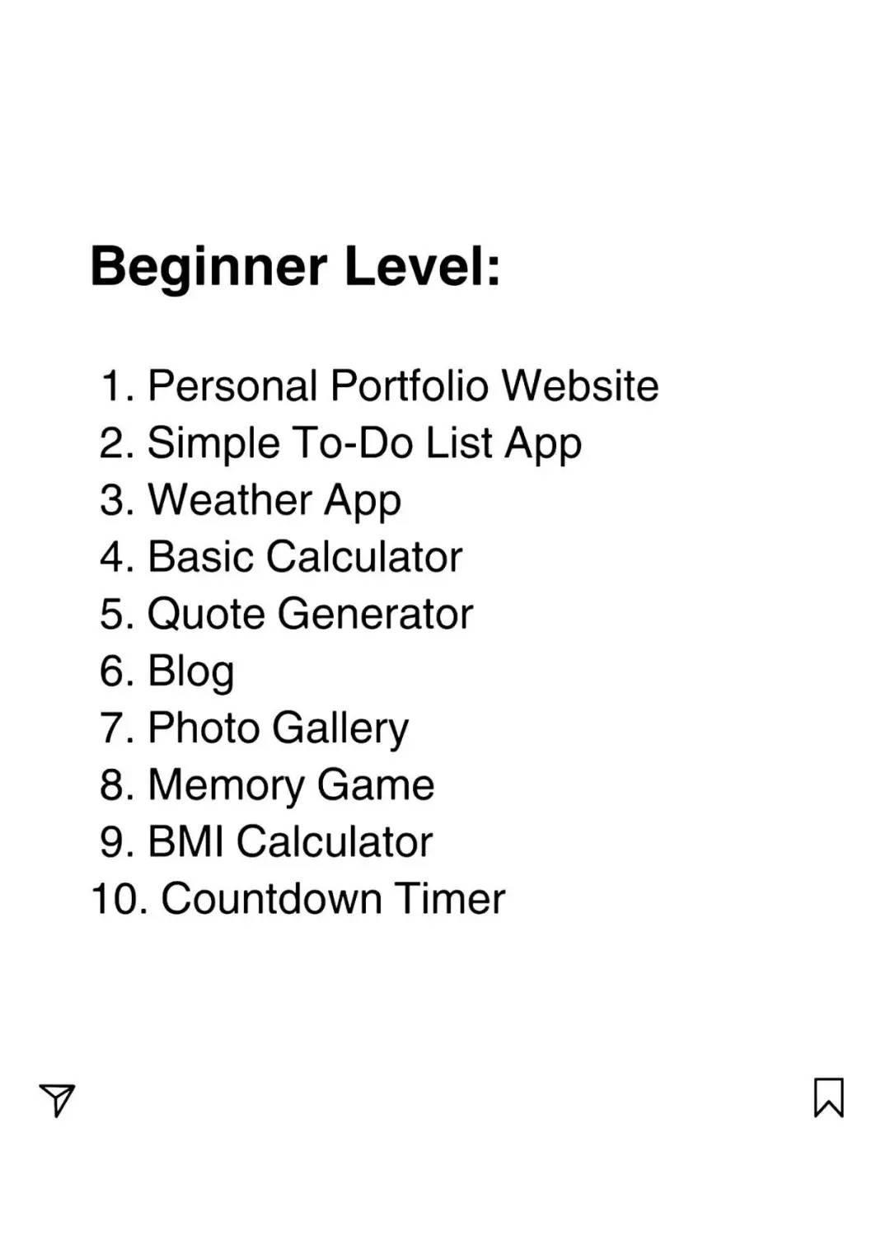

Slide 5
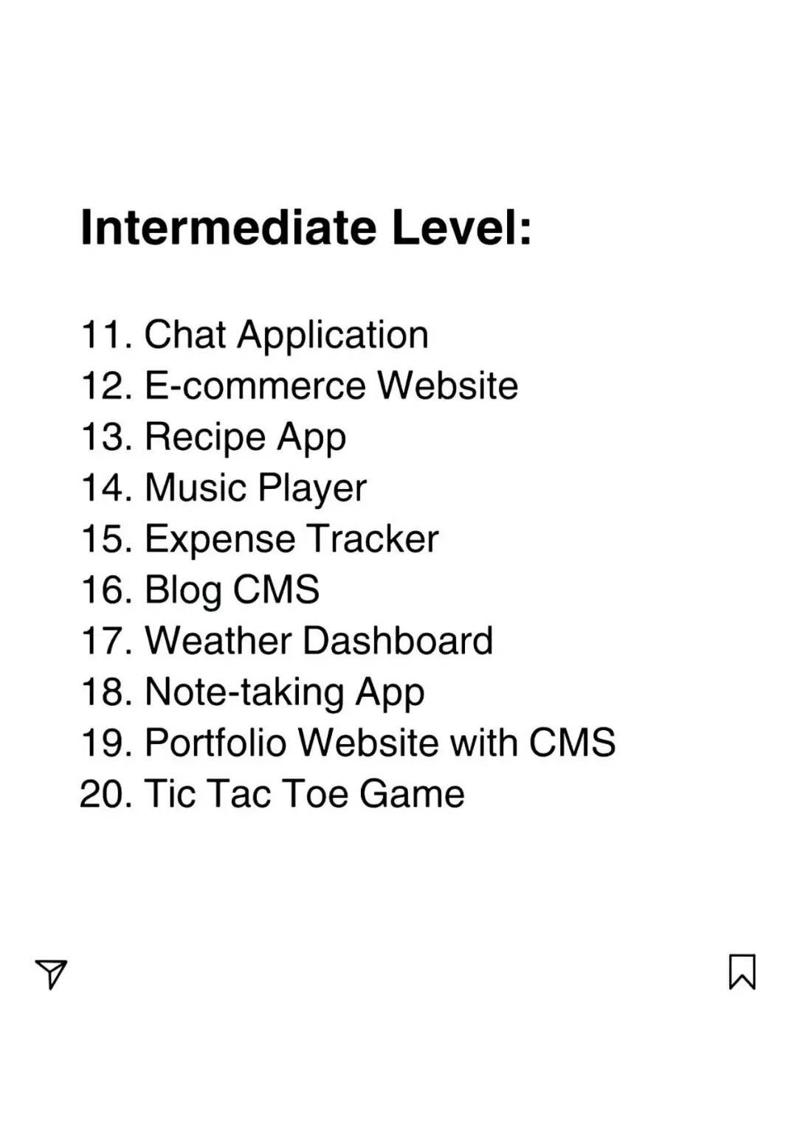
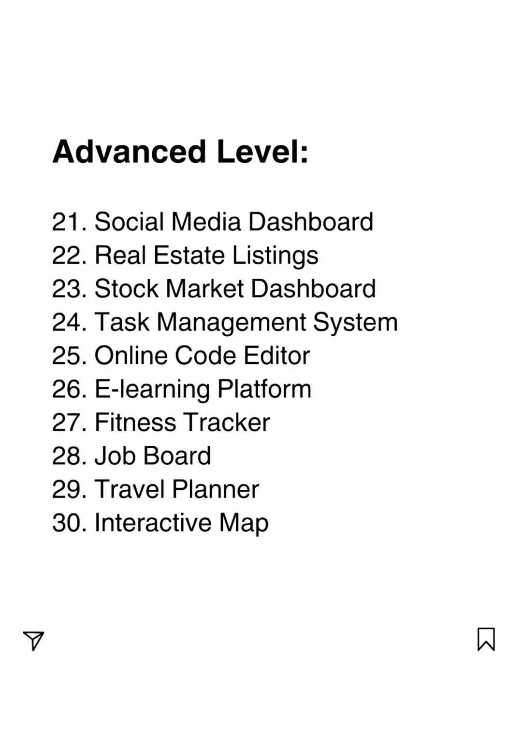

Slide 6
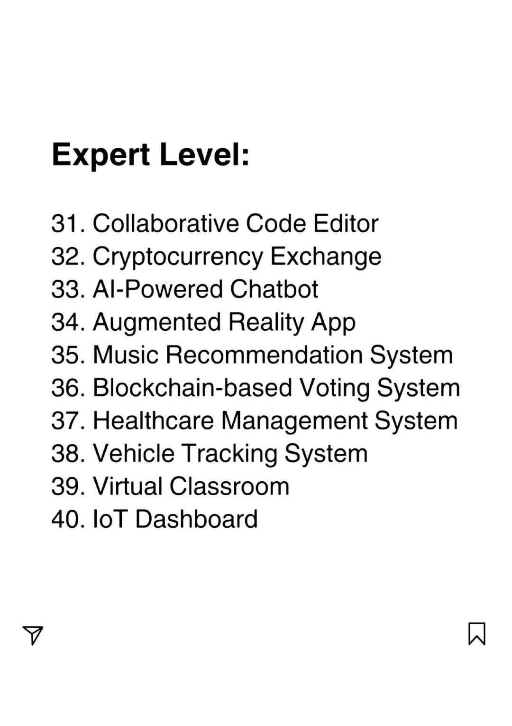

Slide 8
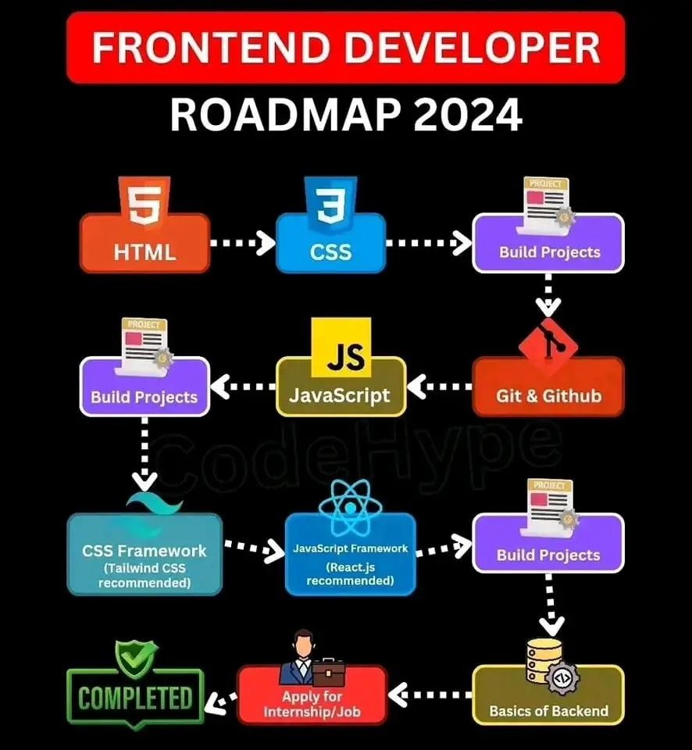
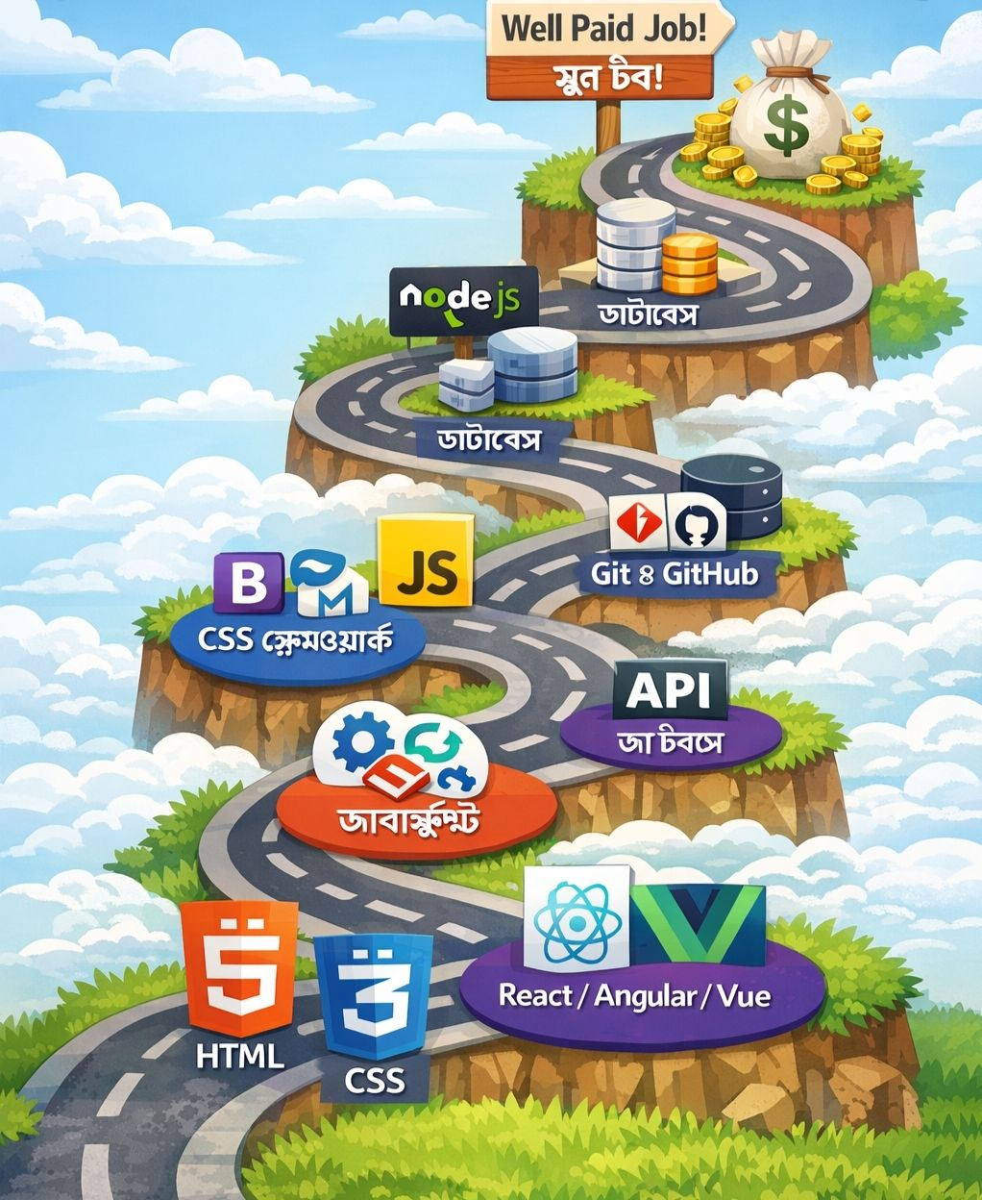
Notes:
Web development roadmap HTML → CSS → CSS frameworks → JavaScript → DOM → Git and GitHub → API → React/Angular/Vue → Node.js → Database → Well Paid Job!

Slide 9
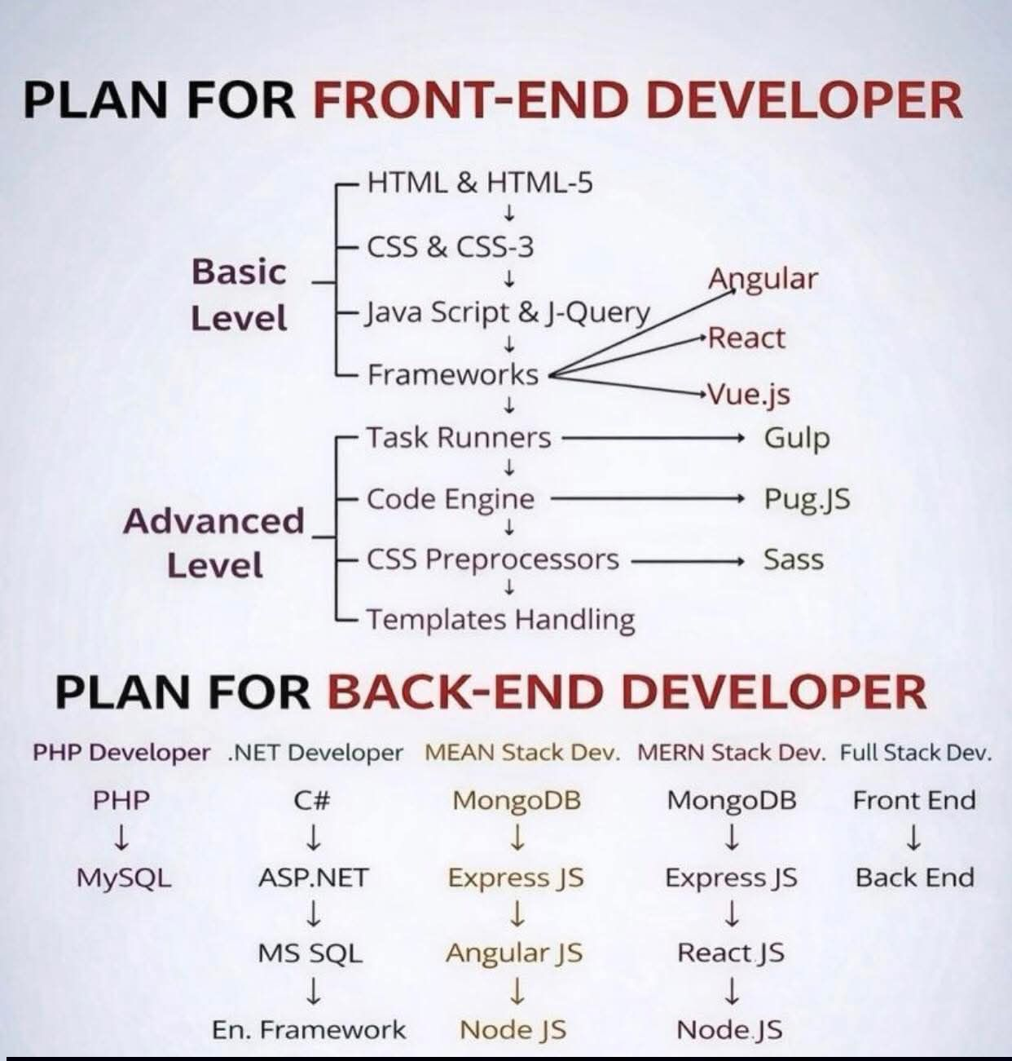

Slide 10
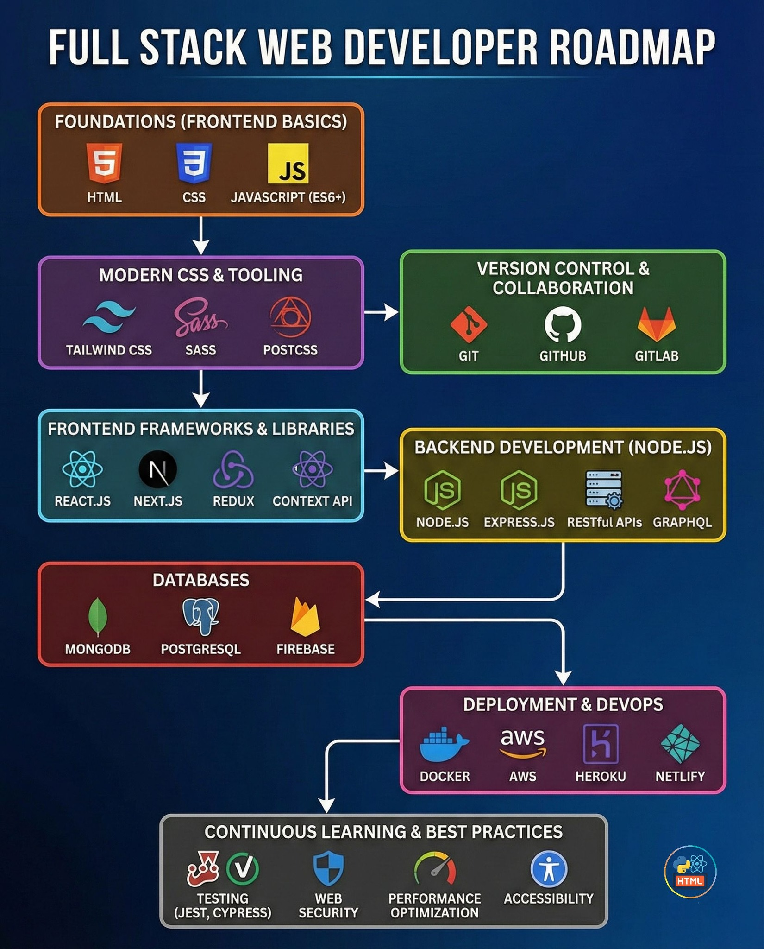
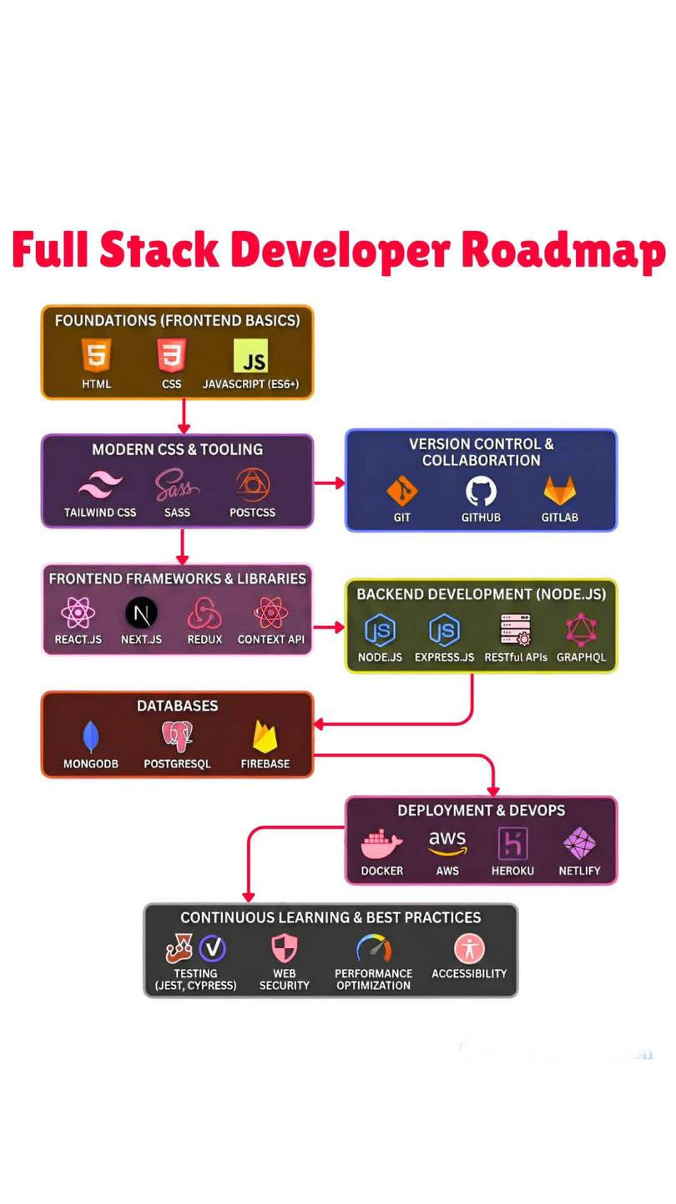

Slide 11
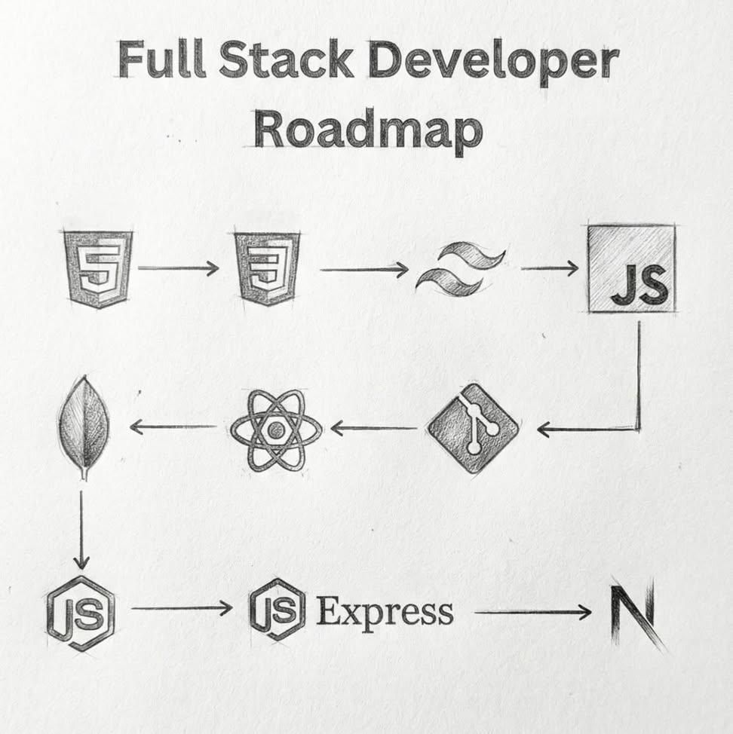
Full Stack Developer Roadmap - HTML ↓ CSS ↓ Sass ↓ JavaScript ↓ React ↓ Git ↓ MongoDB ↓ Node.js ↓ Express ↓ Next.js

Slide 12
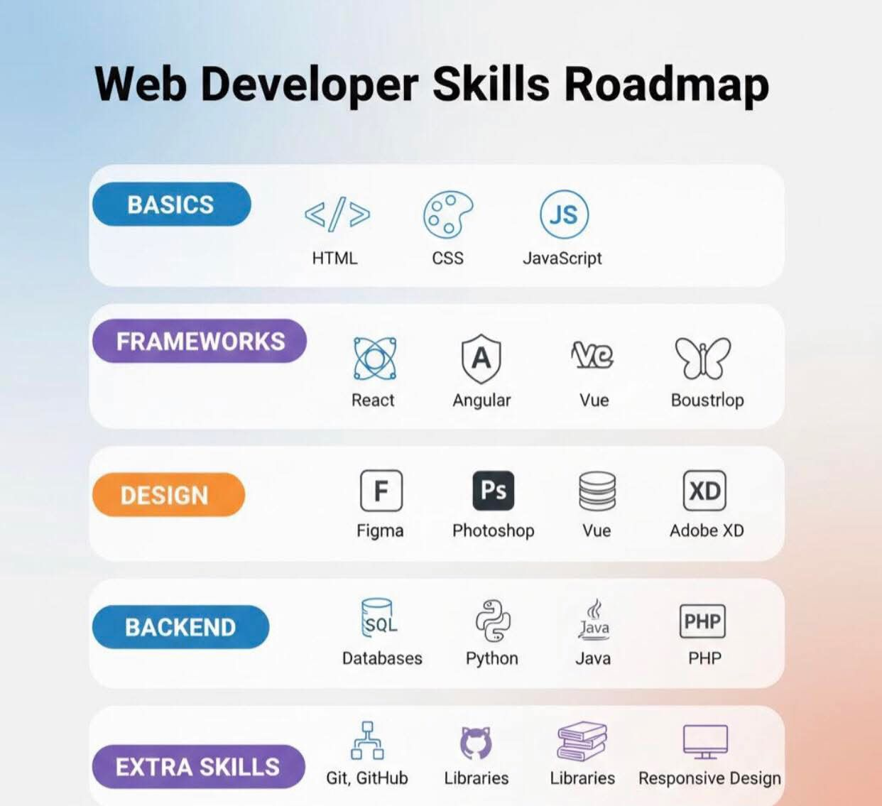

Slide 13
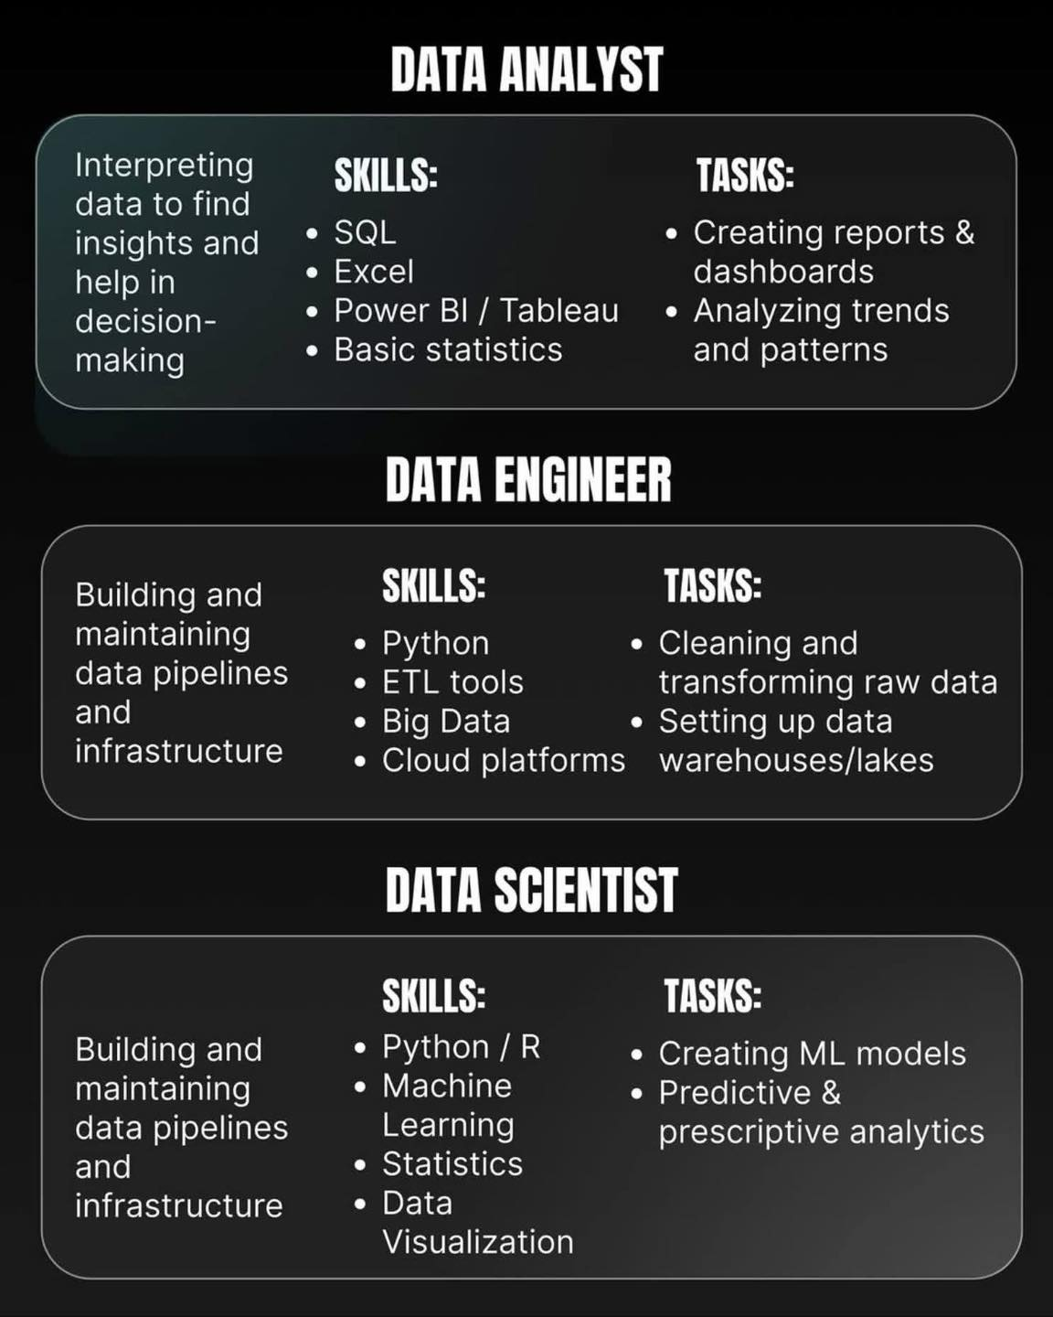

Slide 14
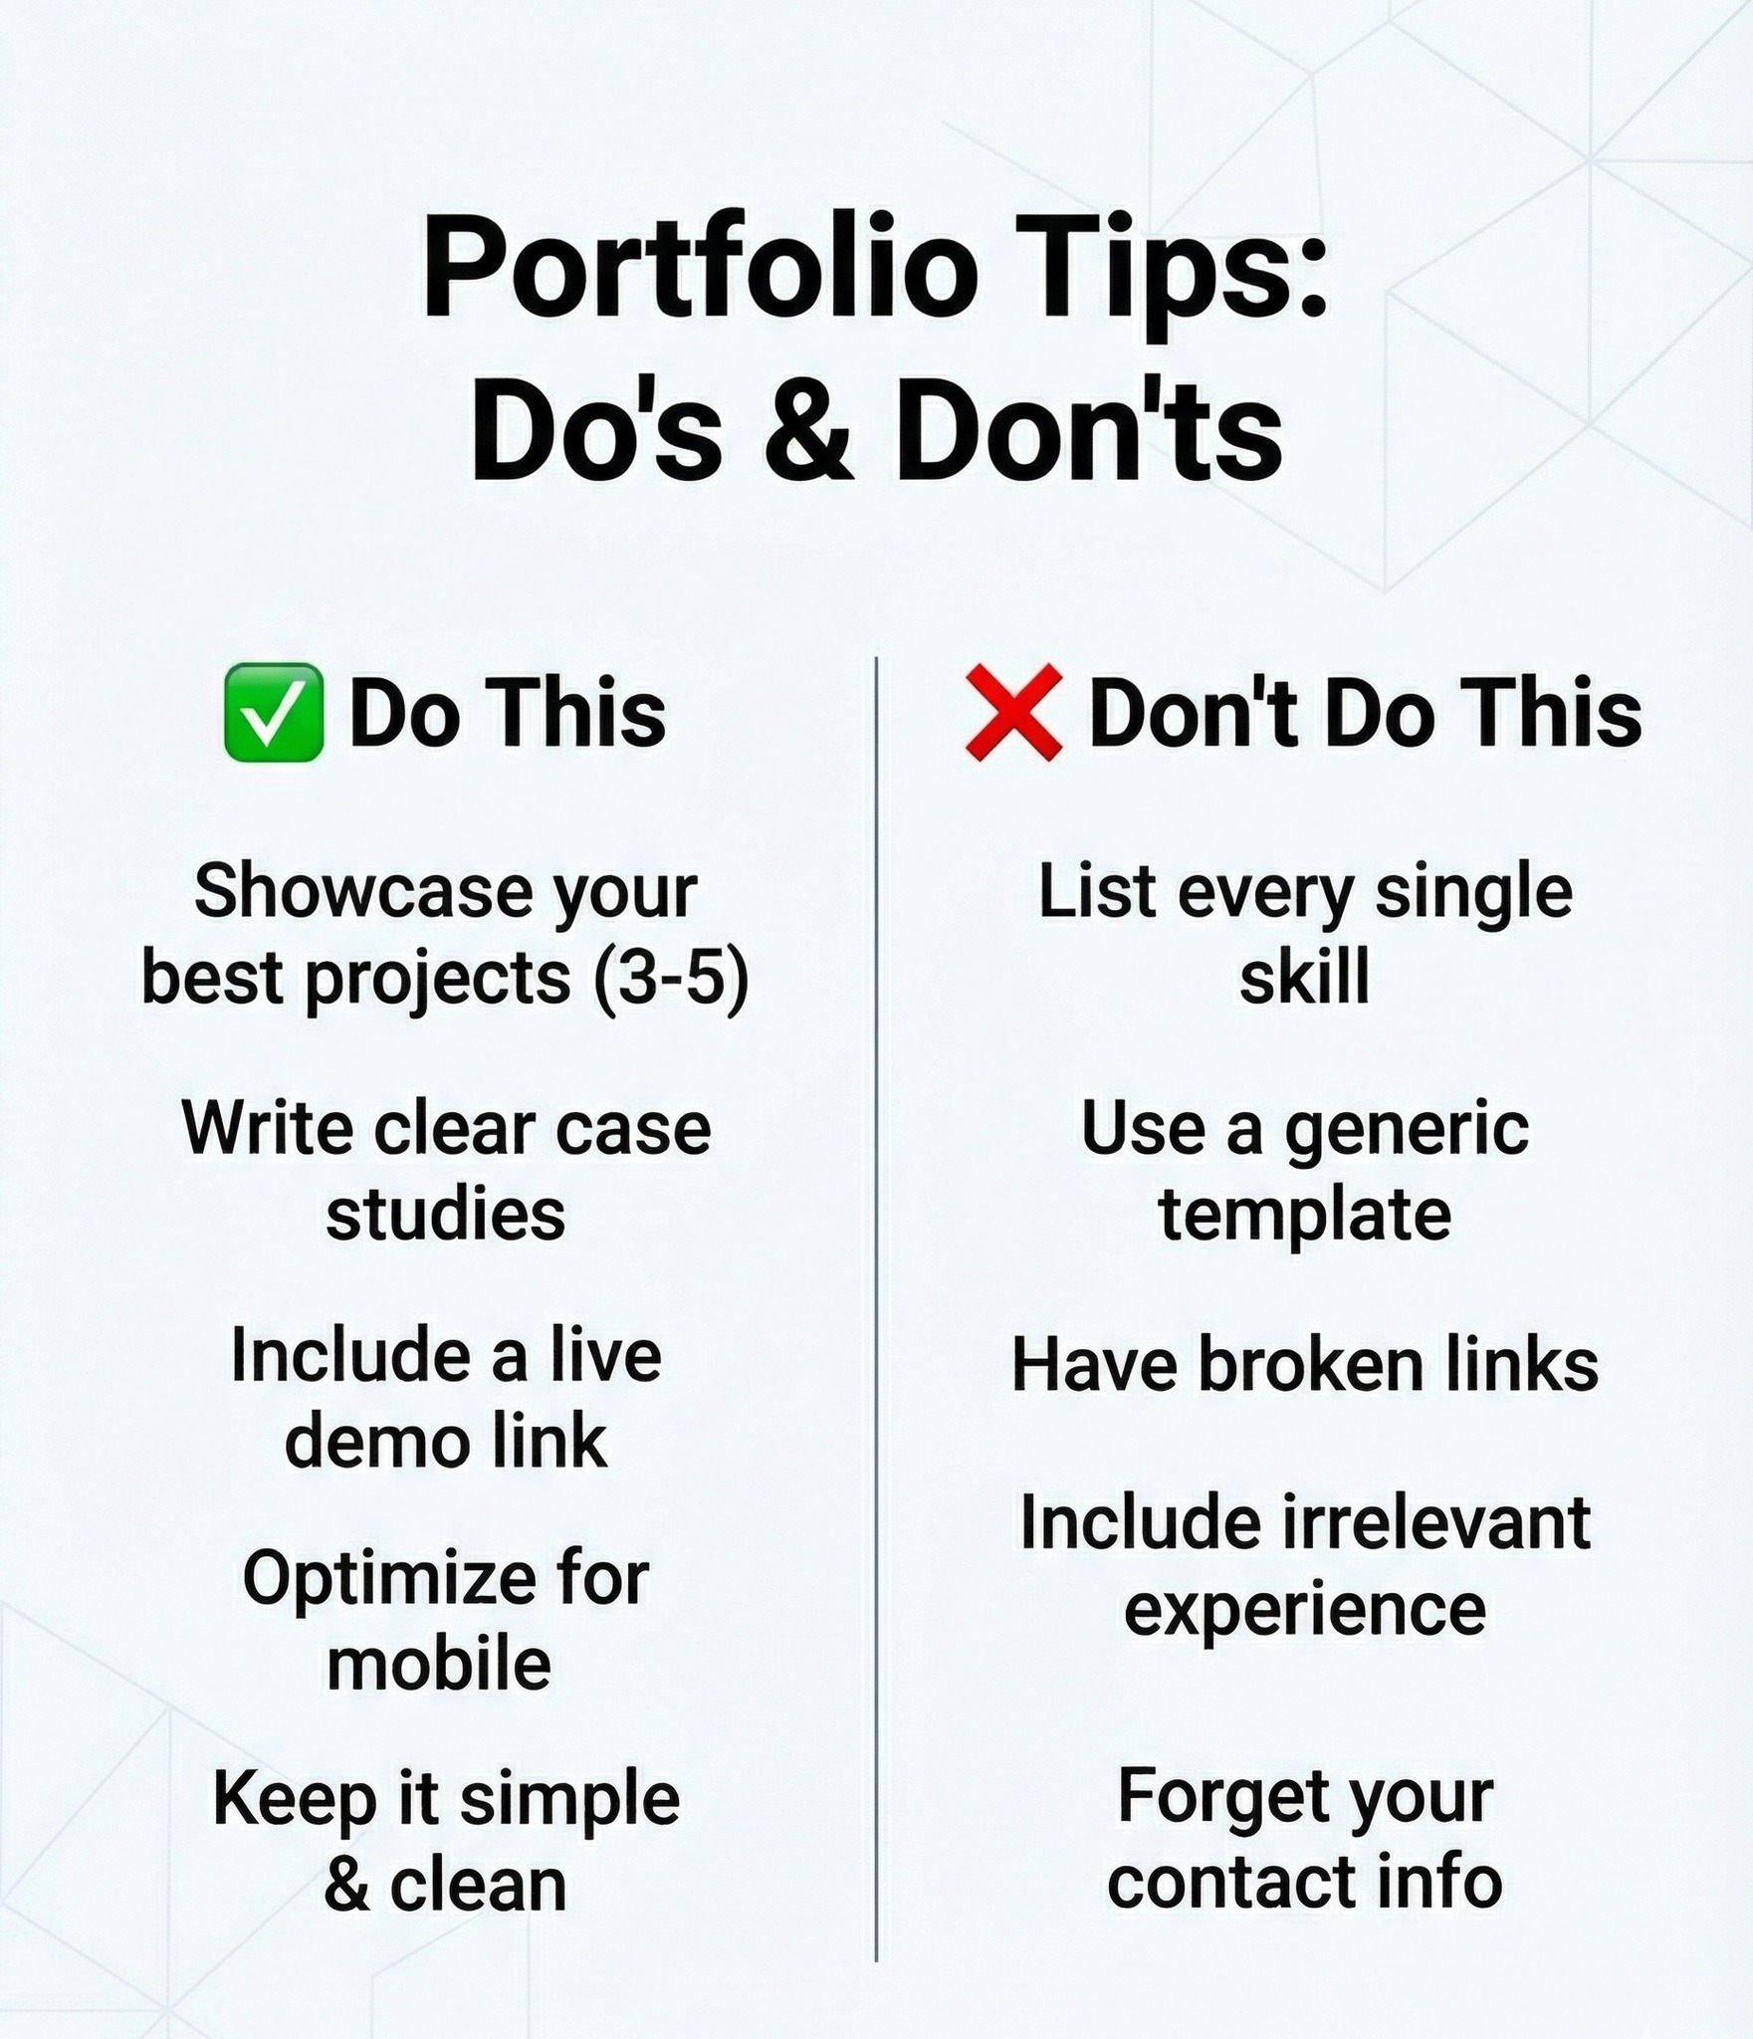
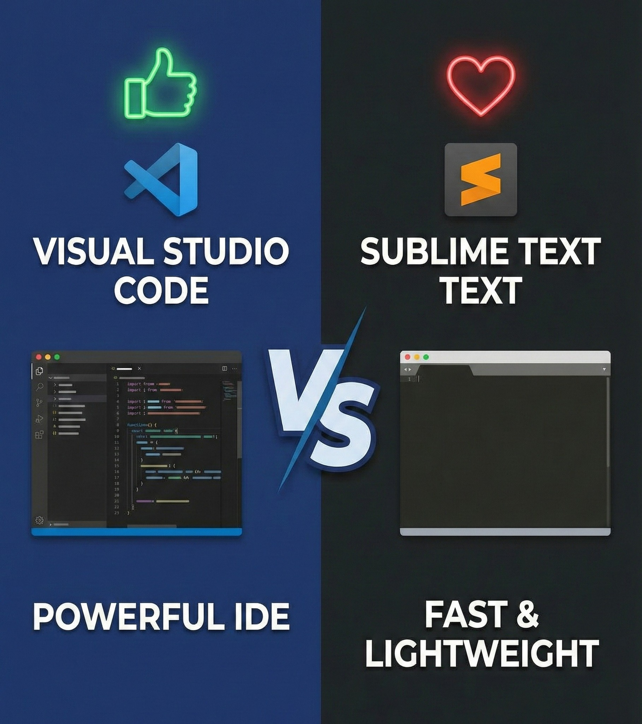
Notes:
Web Development Roadmap: From Basics to Pro Animation Coding >> Animation Coding Zone If you’re starting your journey in **web development**, having a clear roadmap makes all the difference. Here’s a simple path that helped me (and can help many beginners too): **1. Basics** * HTML – structure of the web * CSS – styling and layouts * JavaScript – logic and interactivity **2. Advanced Frontend** * Responsive design * JavaScript ES6+ * Frameworks/Libraries (React, Angular, or Vue) **3. Backend Development** * Basics of servers & APIs * Node.js / Python / PHP * Databases (MySQL, MongoDB) **4. Version Control & Tools** * Git & GitHub * Package managers * Deployment basics **5. Practice & Projects** * Build real projects * Improve problem-solving * Keep learning and iterating **Special Mention:** A big shoutout to w3schools — one of the best platforms for beginners. Its simple explanations, examples, and hands-on practice make learning web technologies much easier and more approachable. Consistency + practice + the right resources = growth

Slide 15
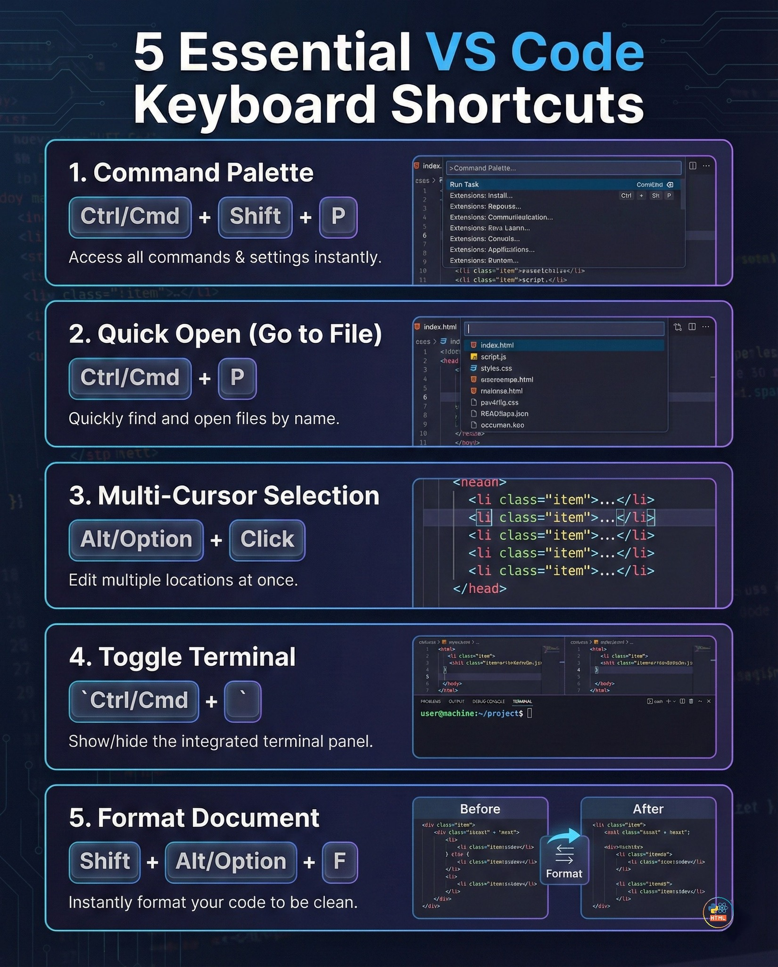

Slide 16
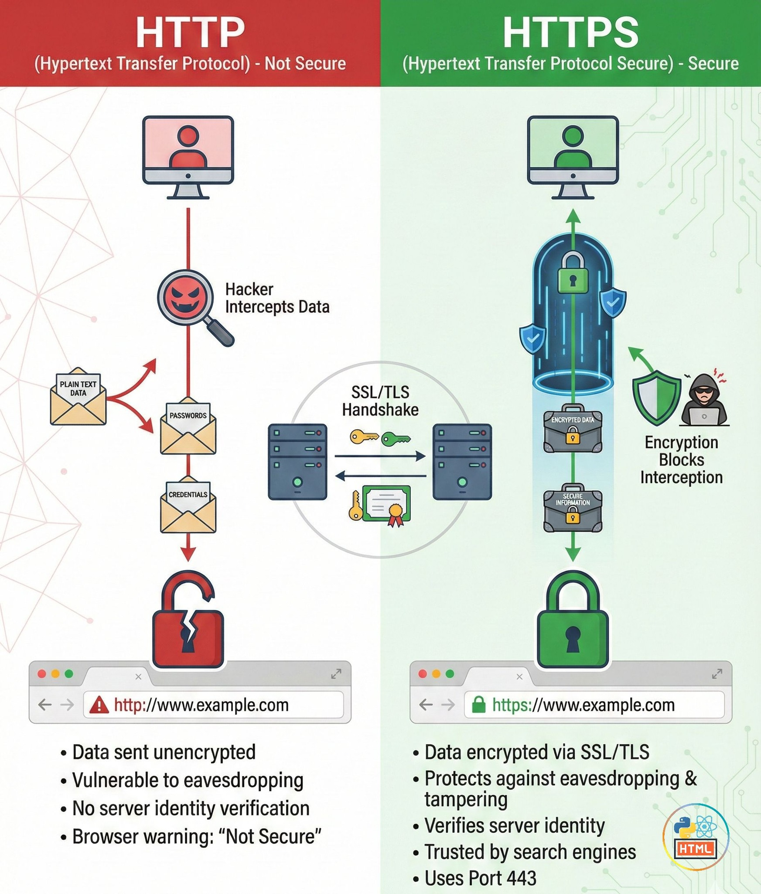

Slide 18
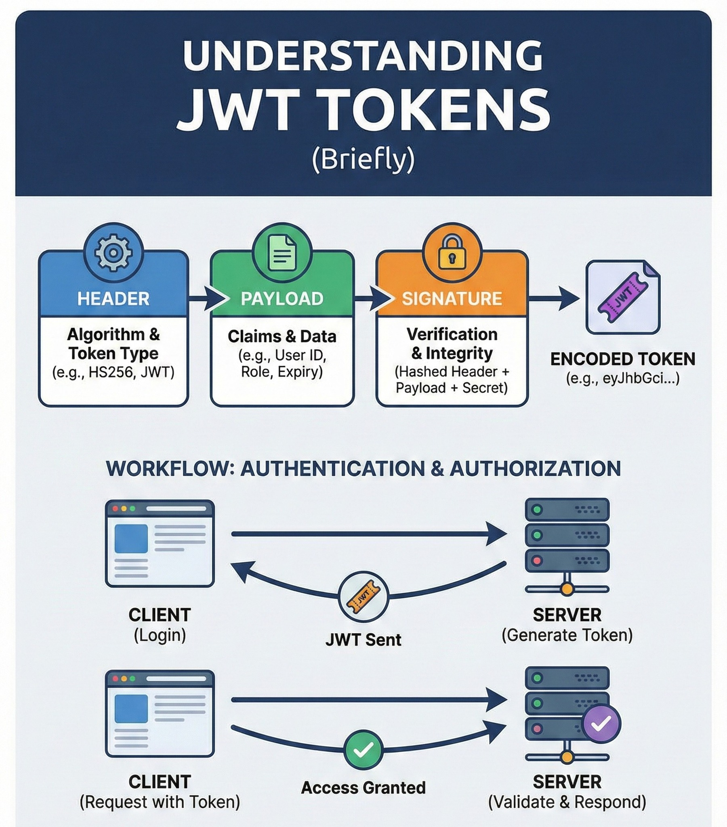
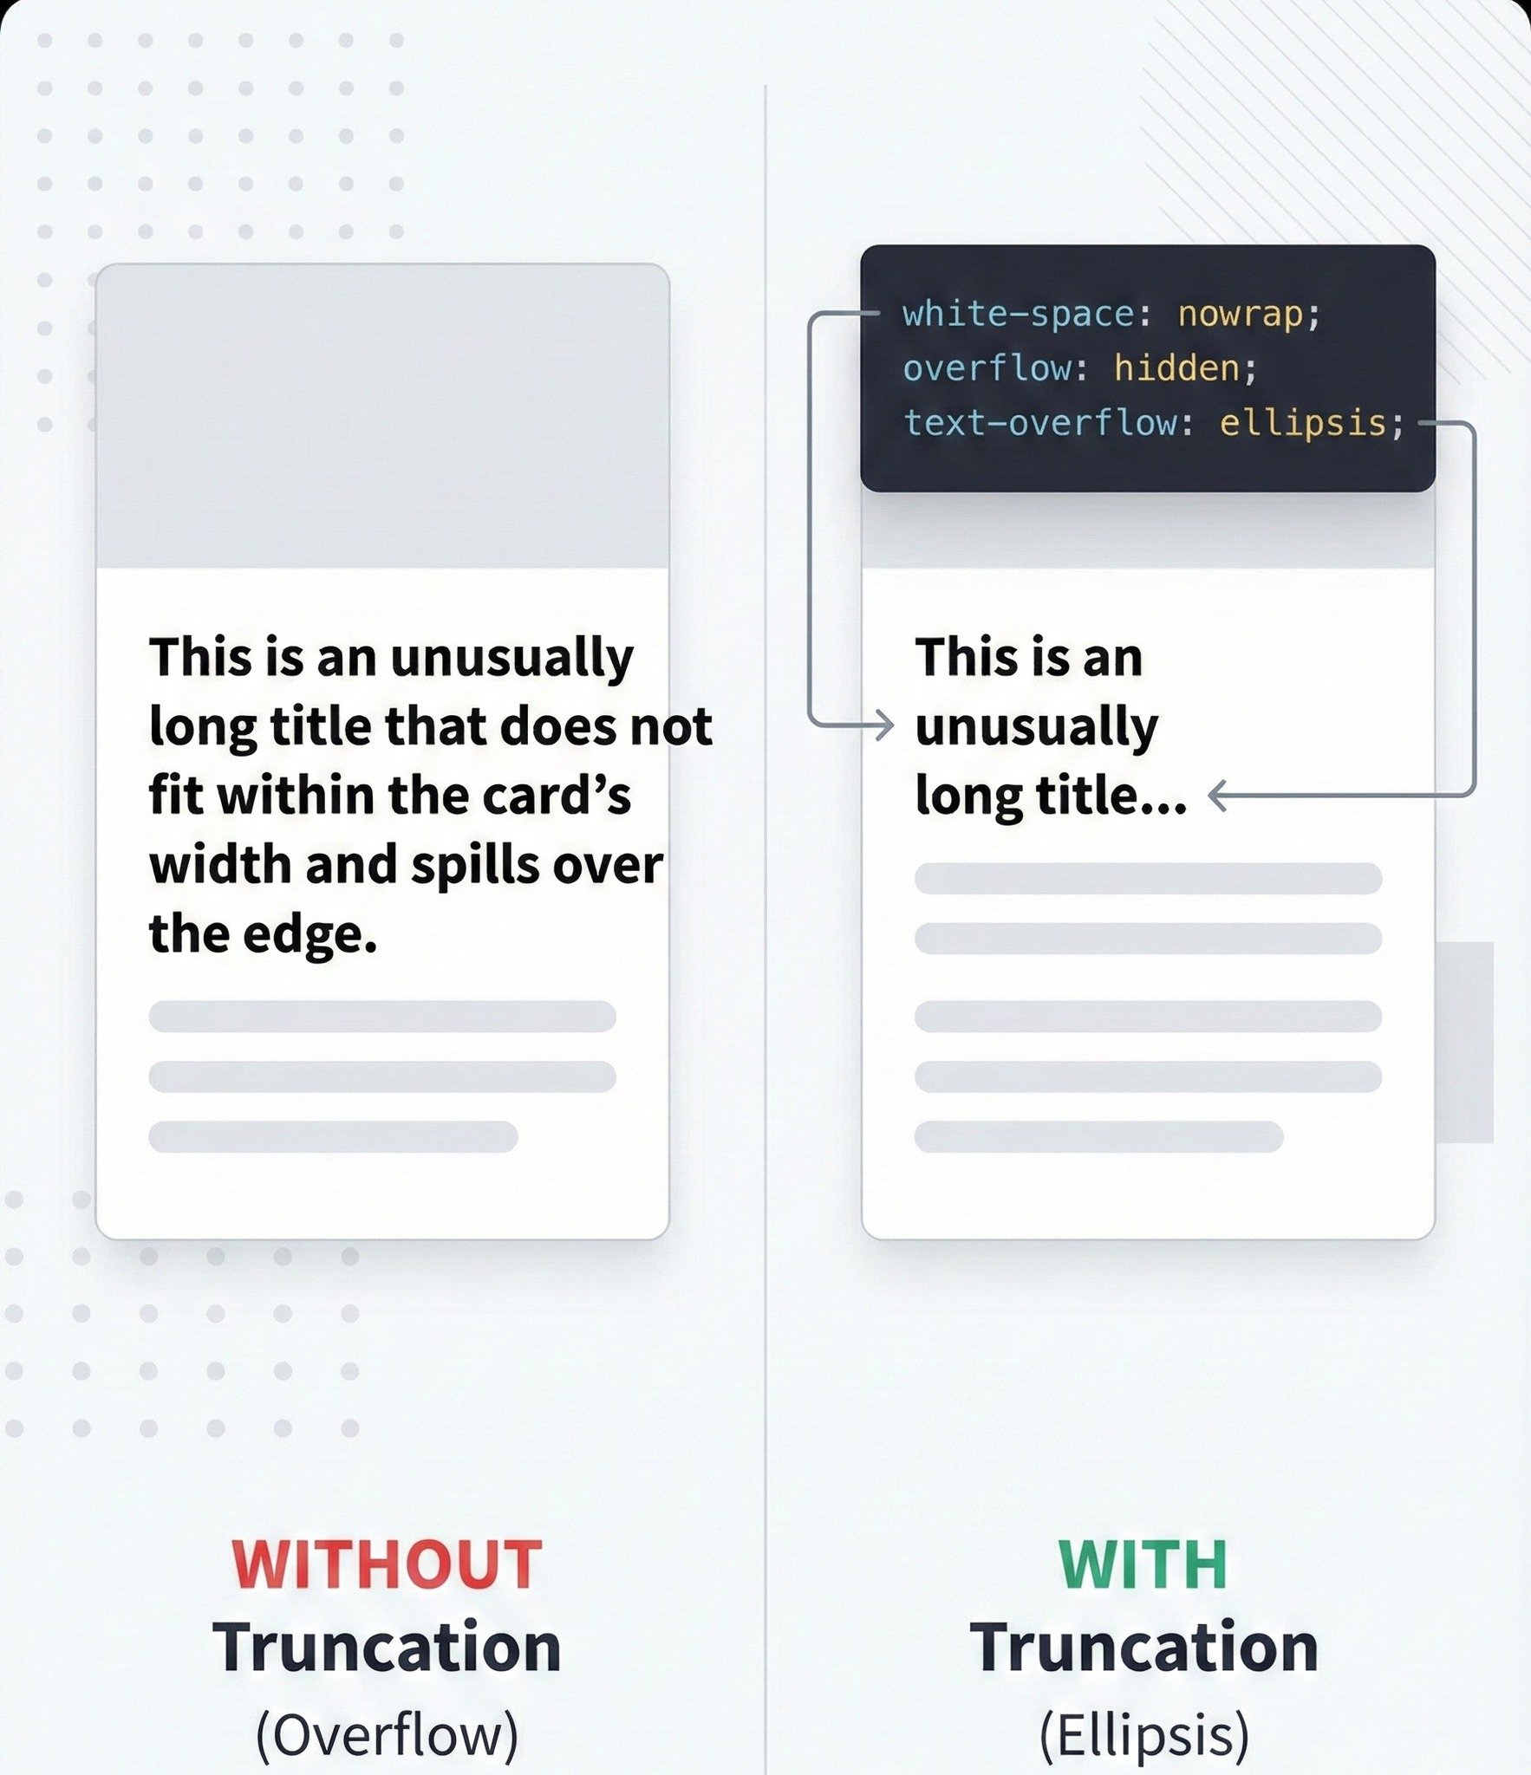

Slide 19
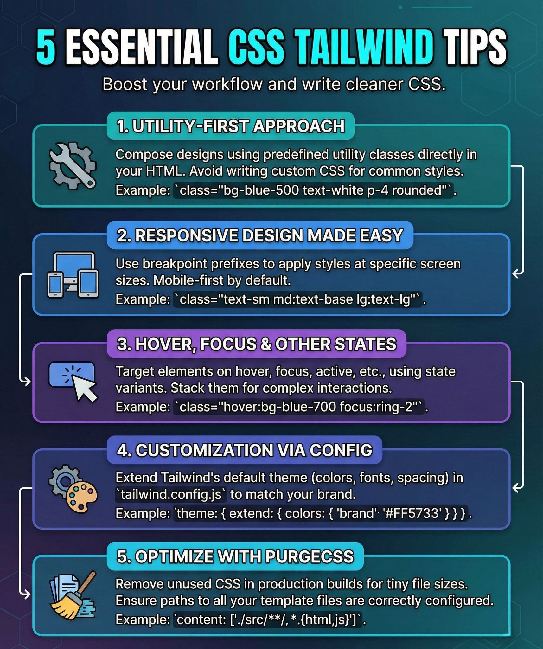

Slide 20
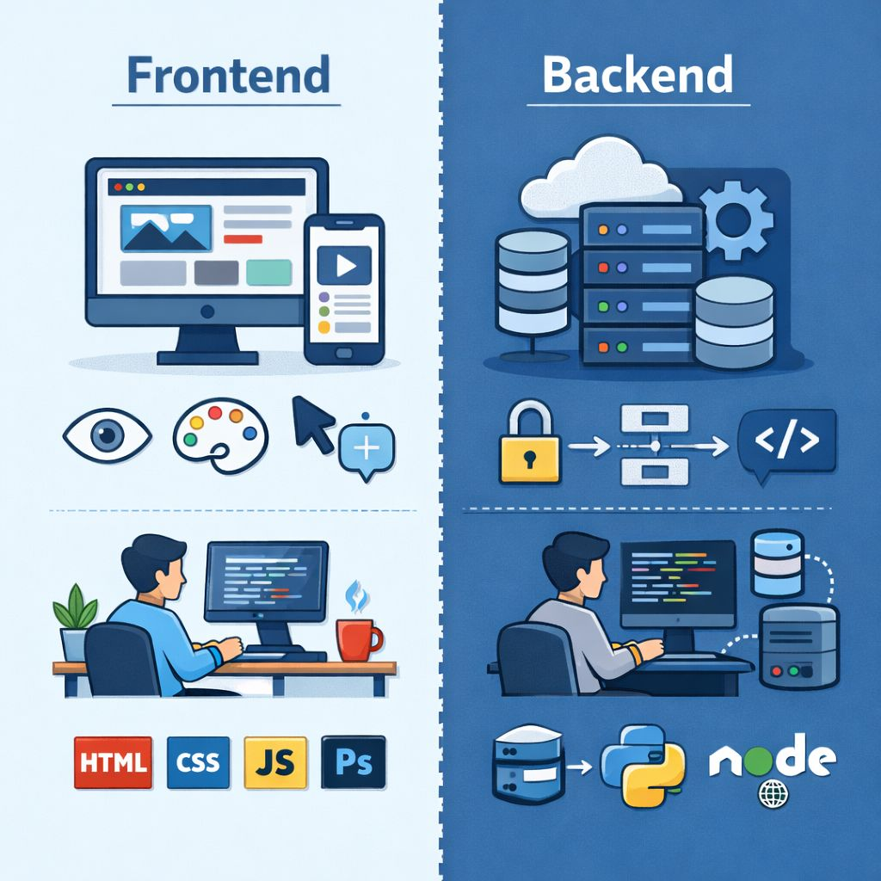
Frontend: Not only PS. Use UI/UX or Top trending tools Figma, XD etc

Slide 23
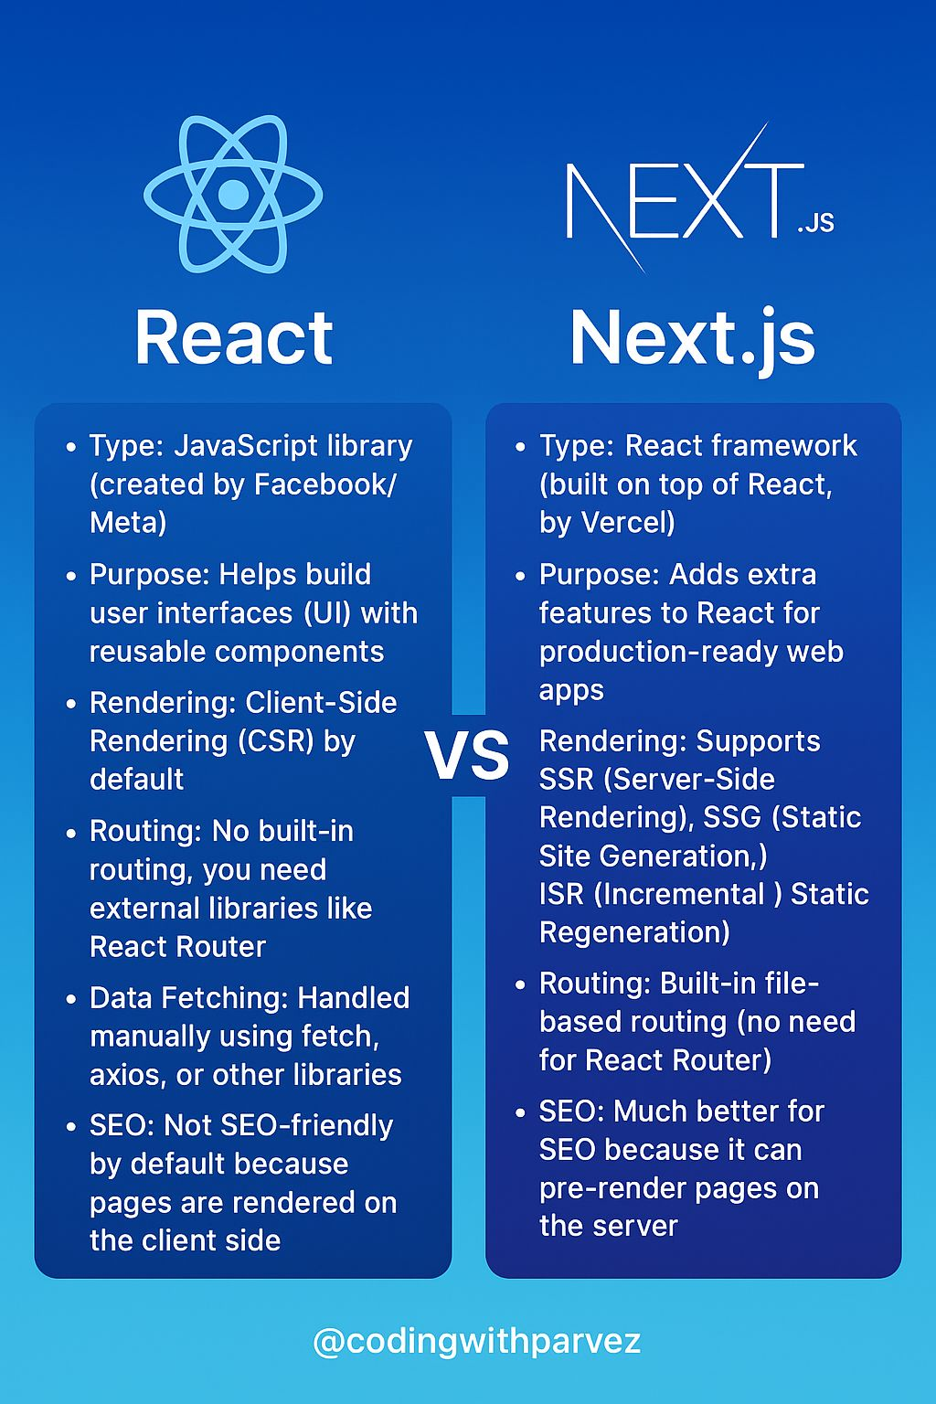
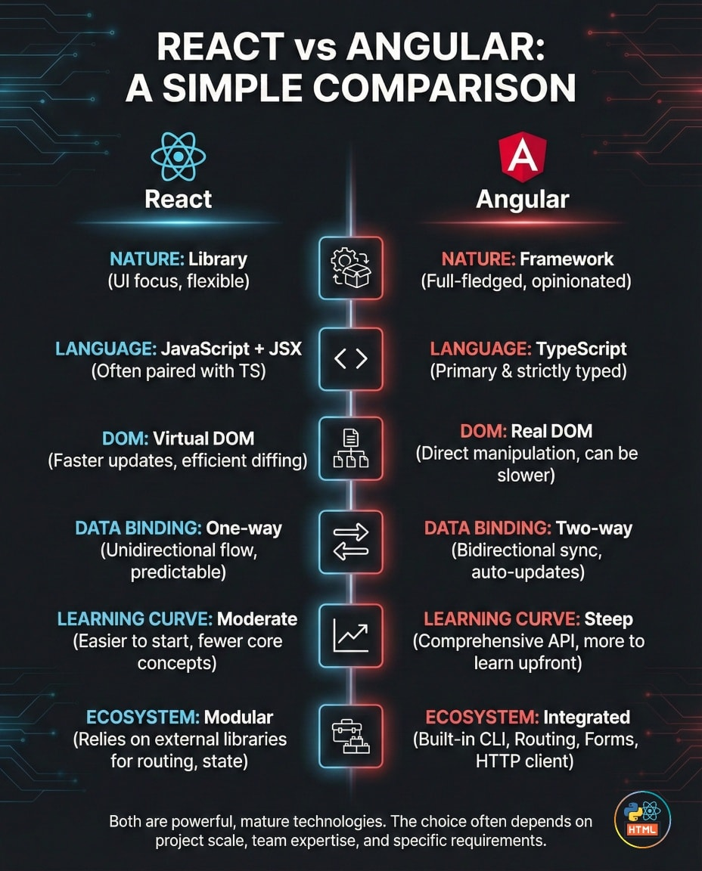

Slide 24
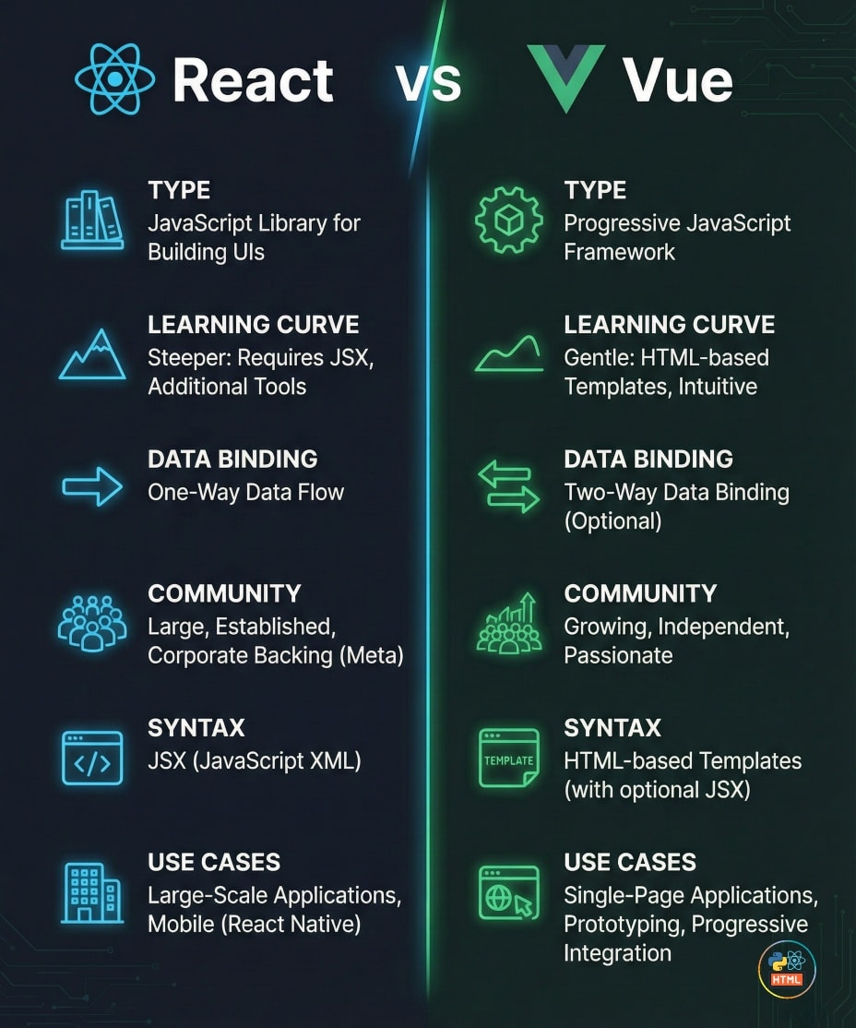

Slide 25
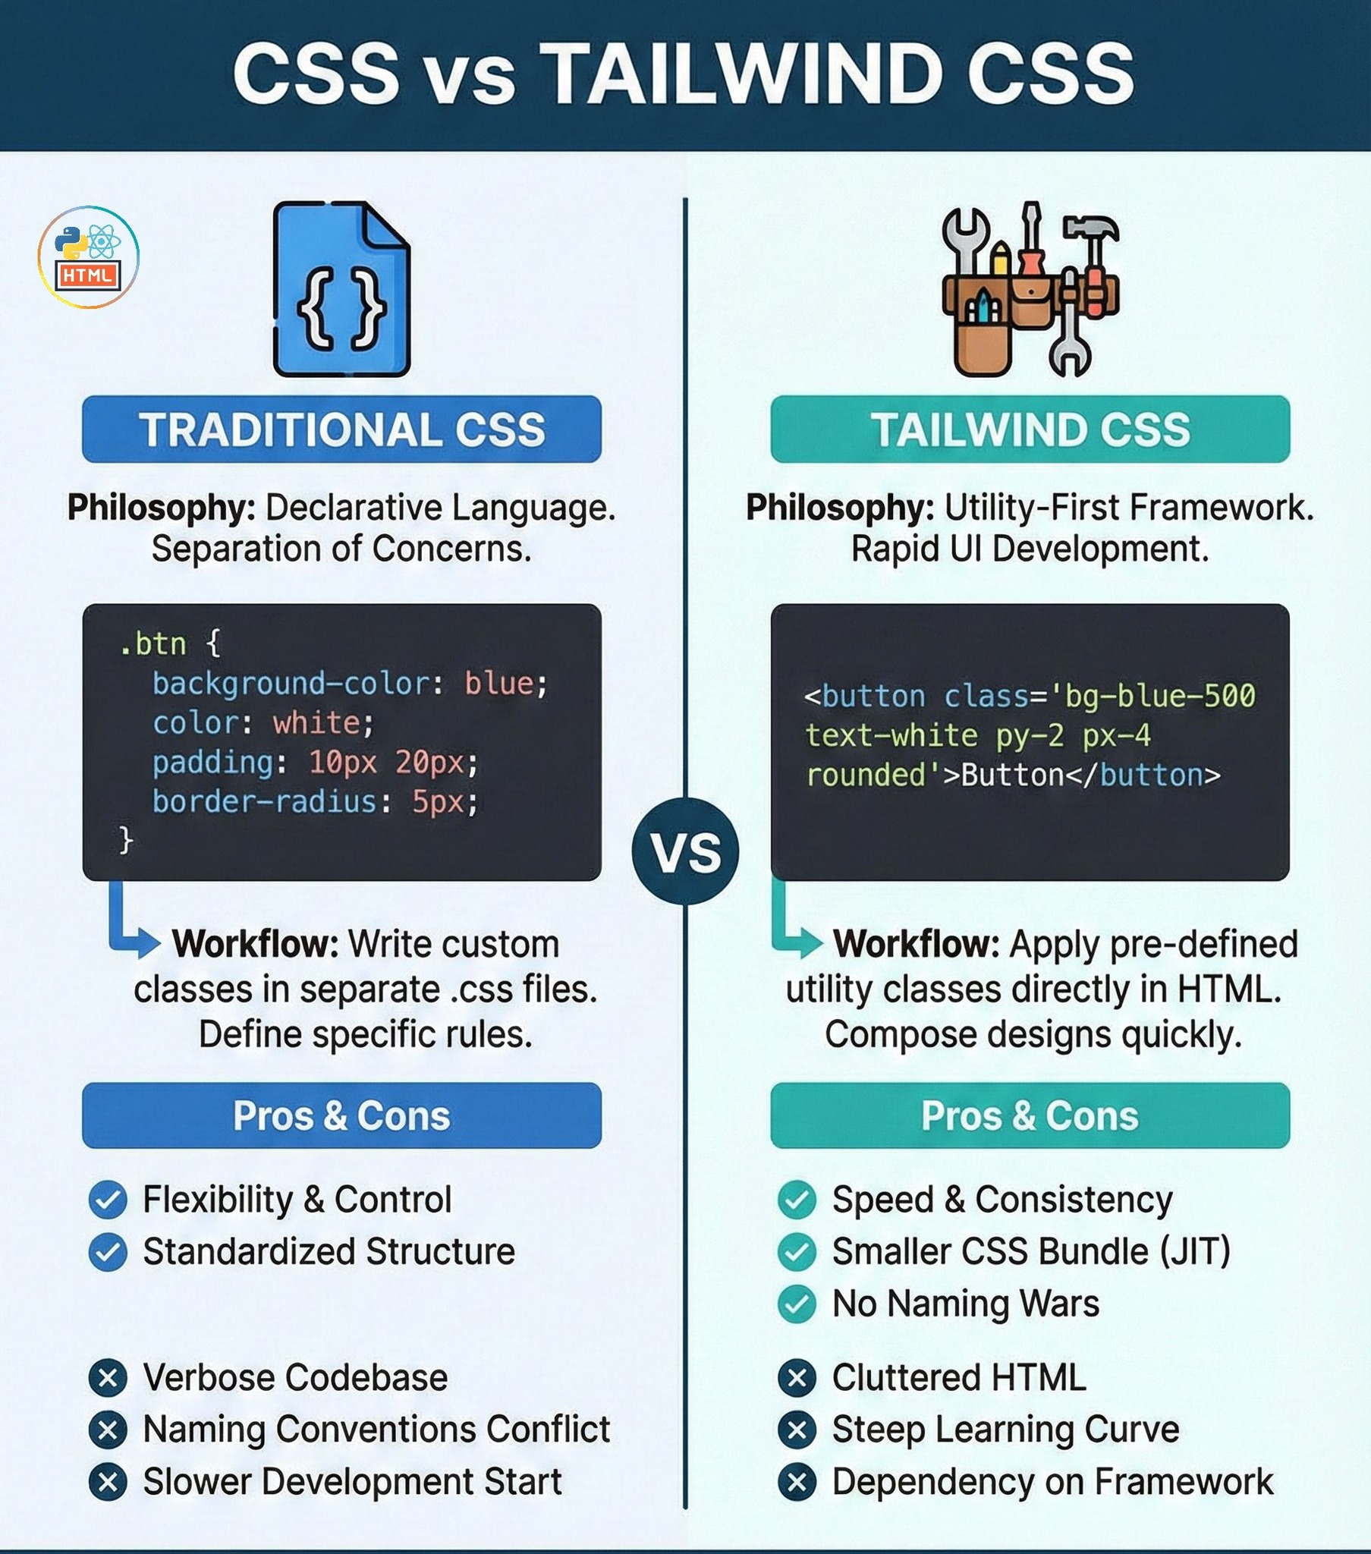

Slide 26
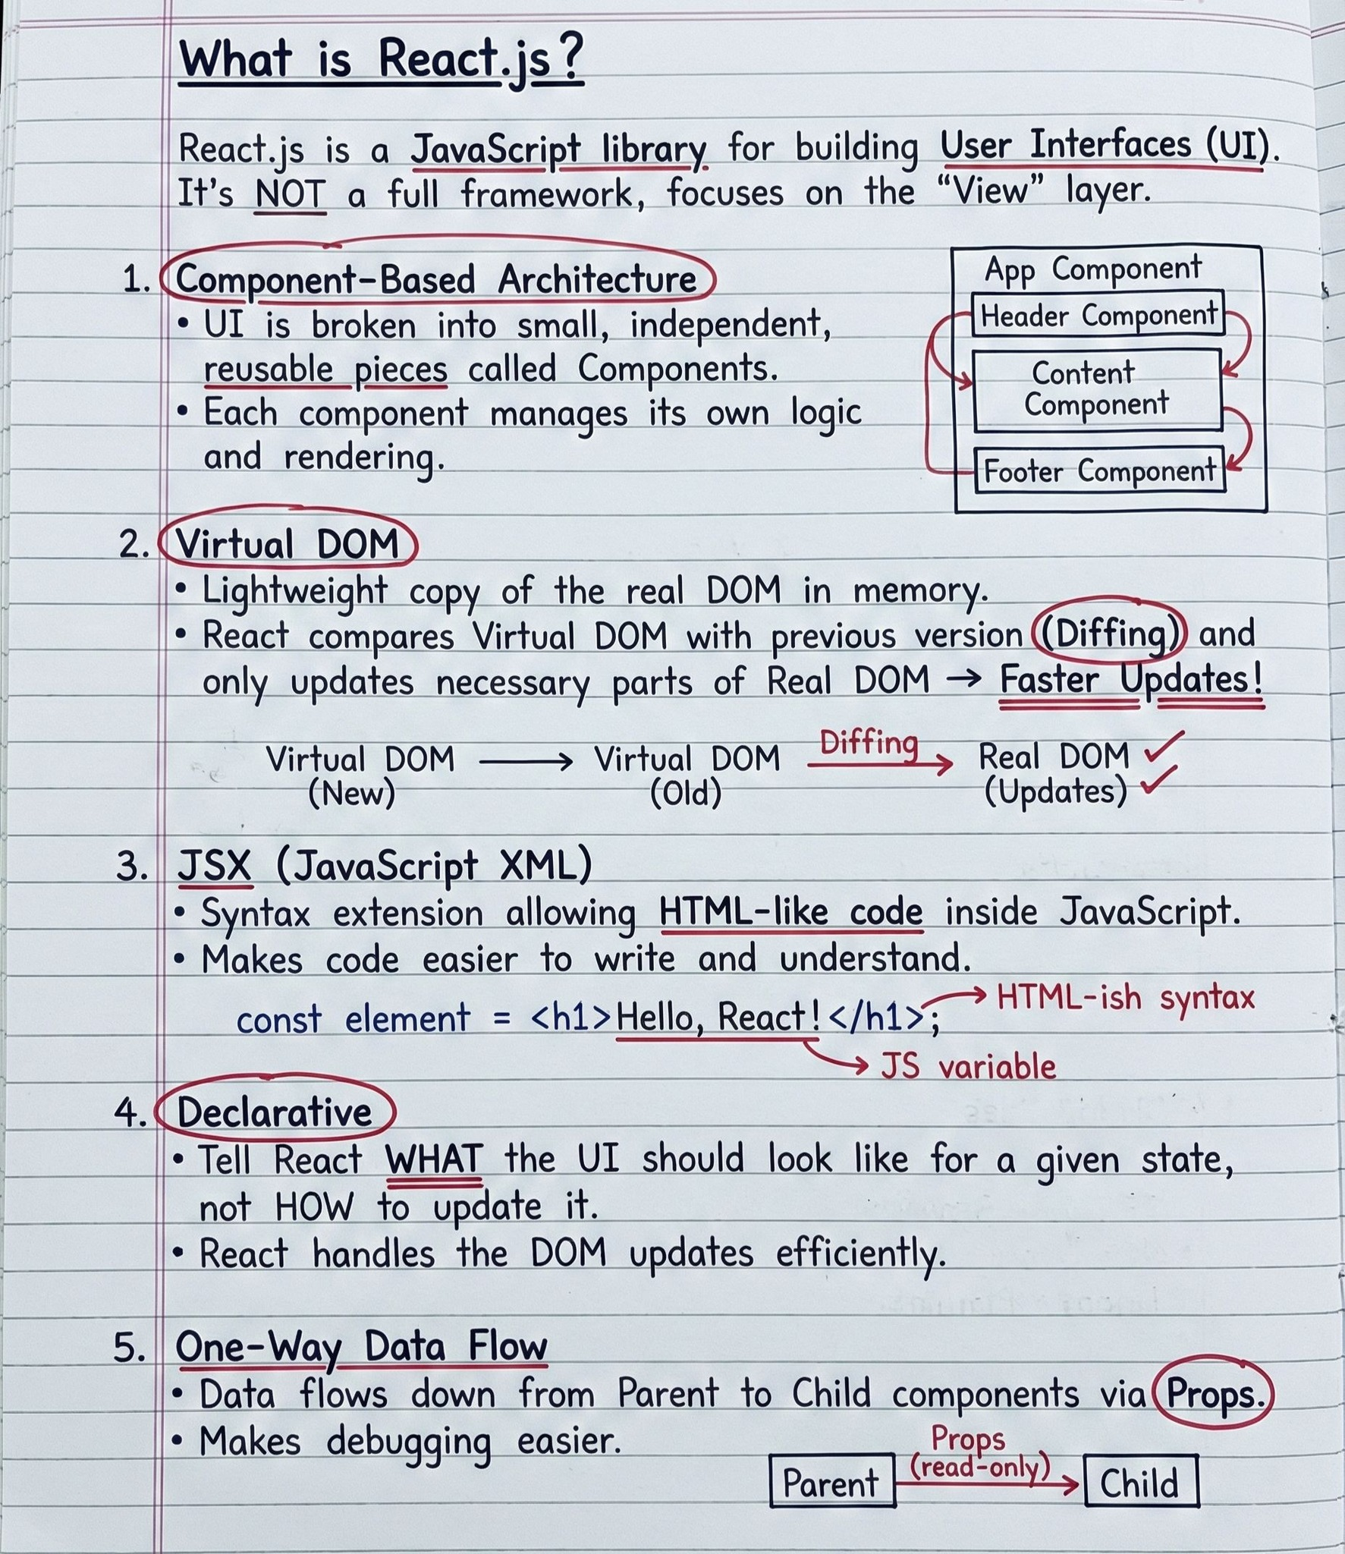
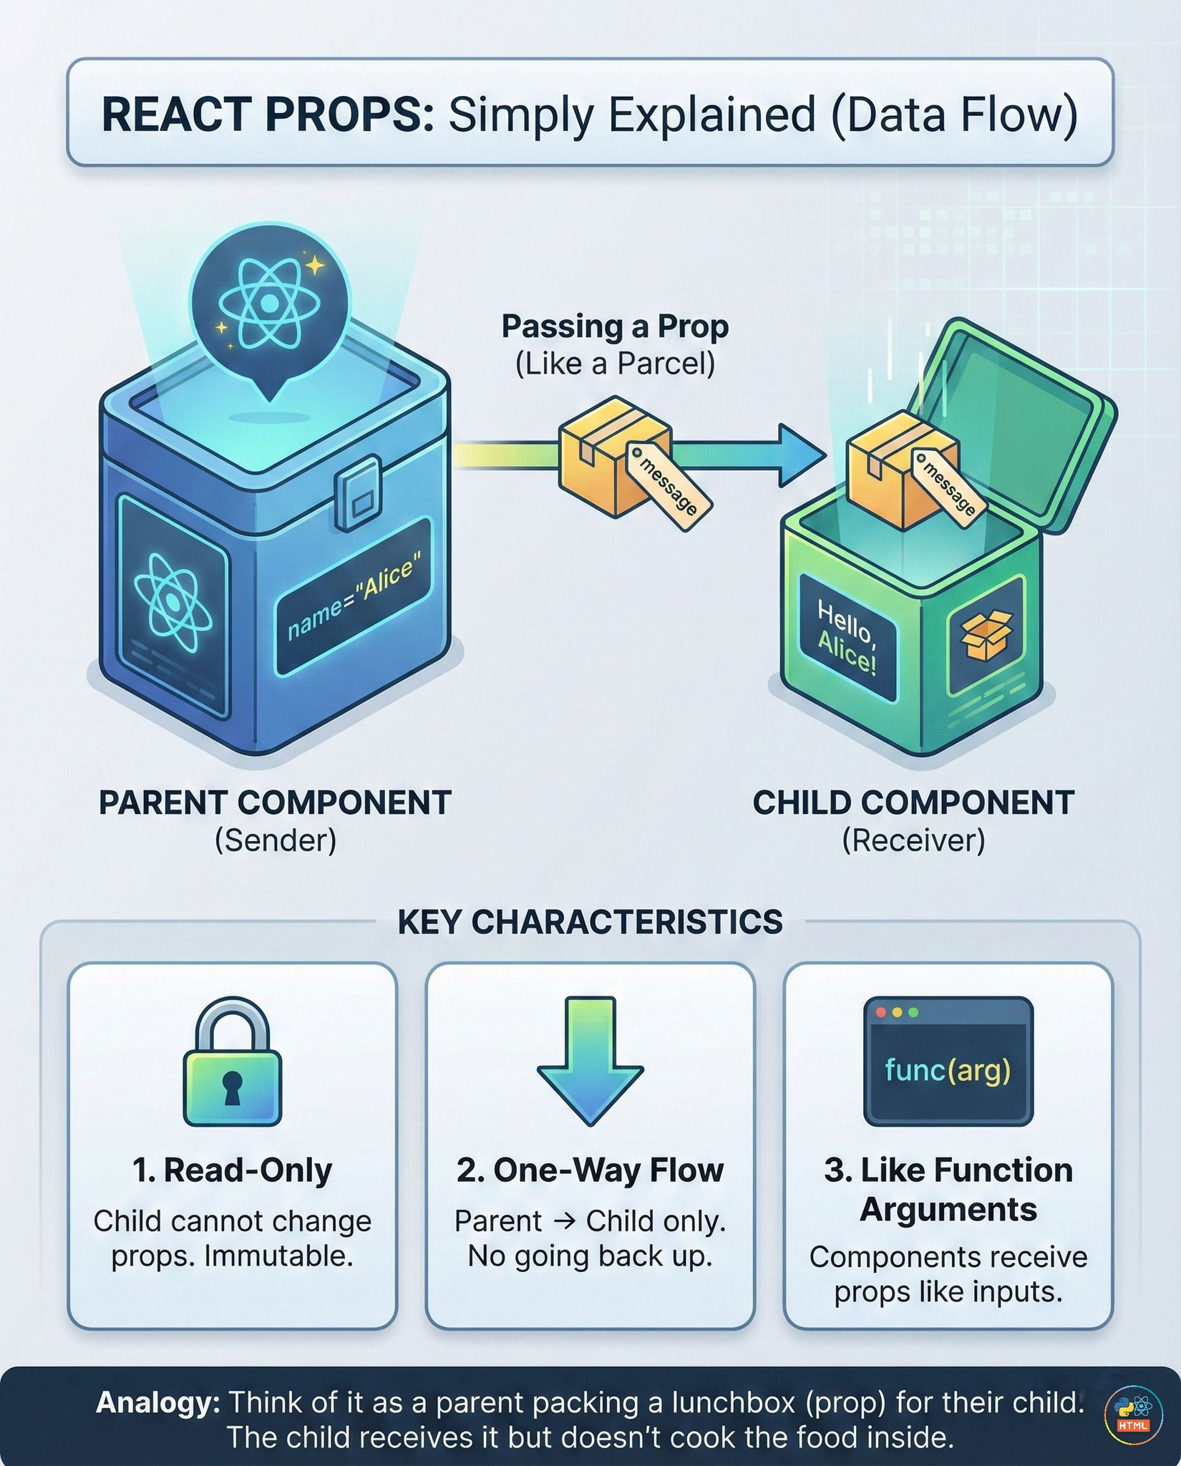

Slide 28
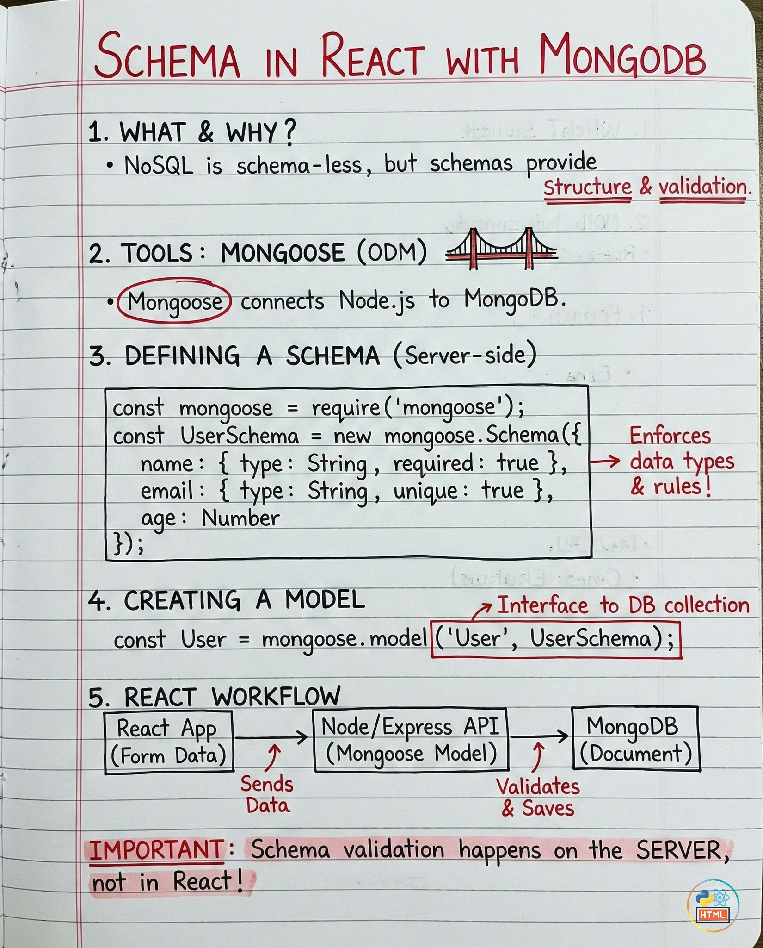
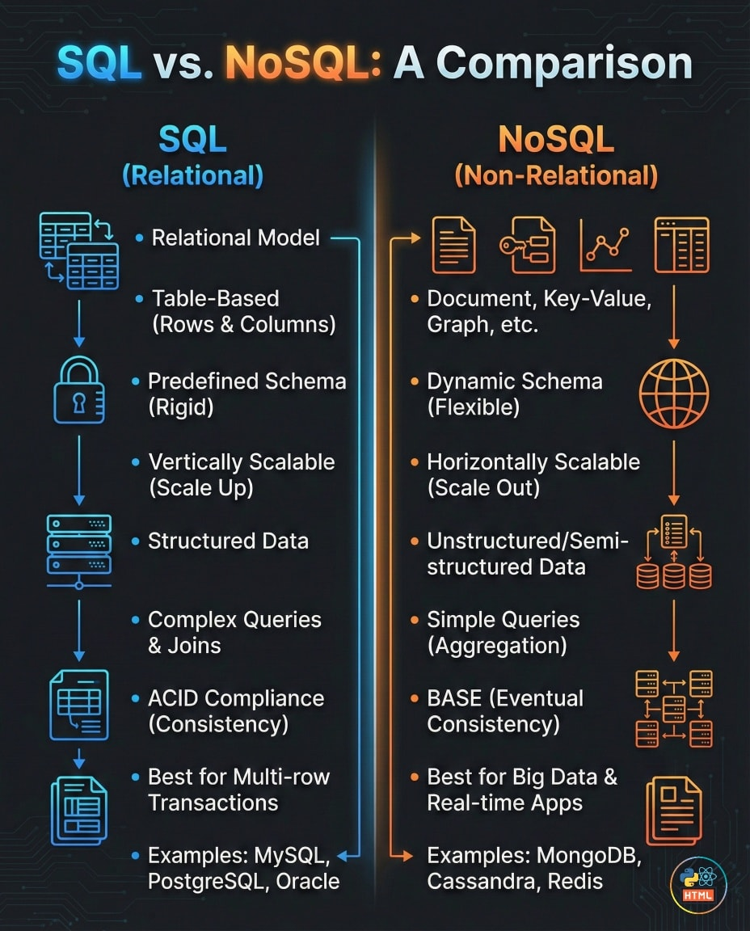

Slide 29
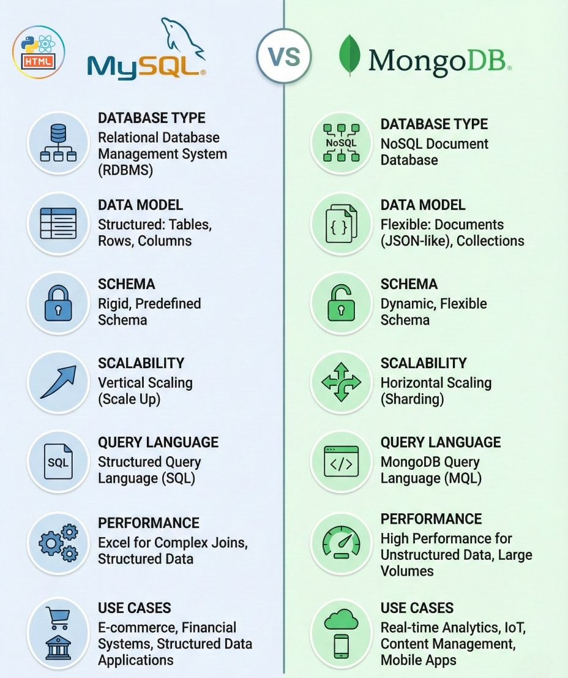
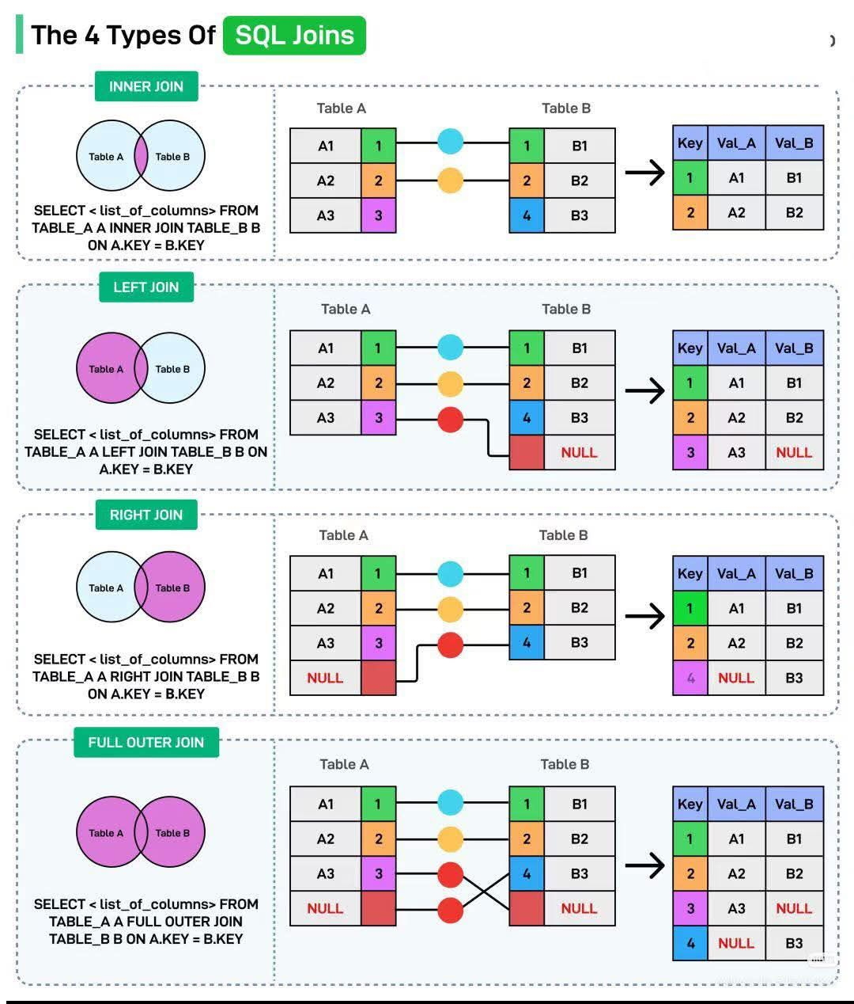

Slide 30
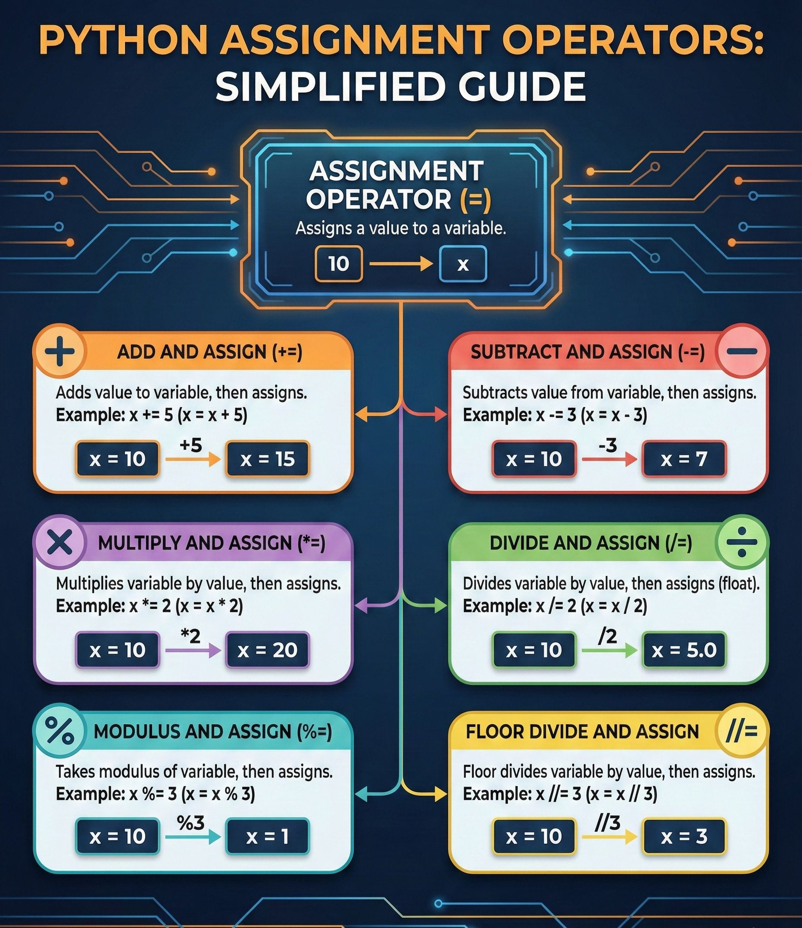
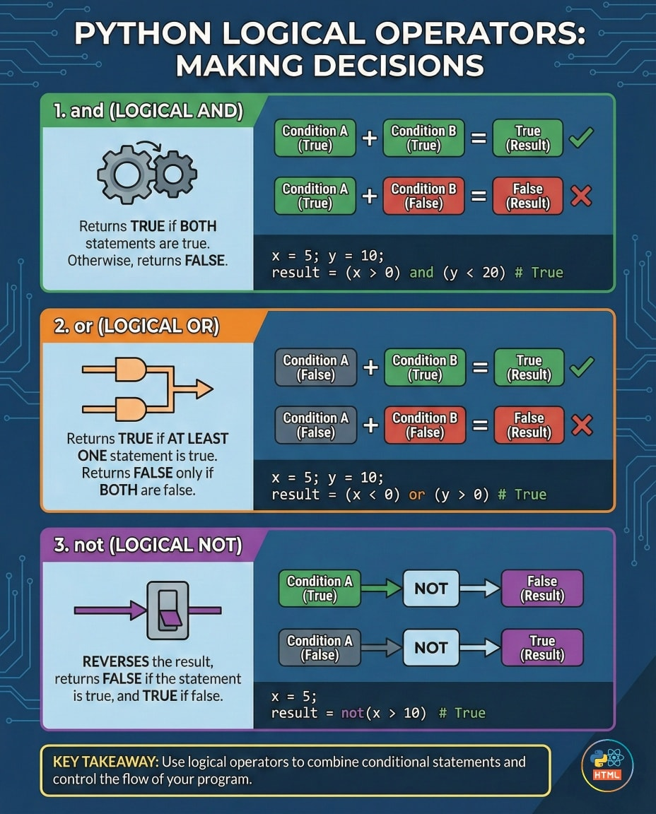

Slide 31
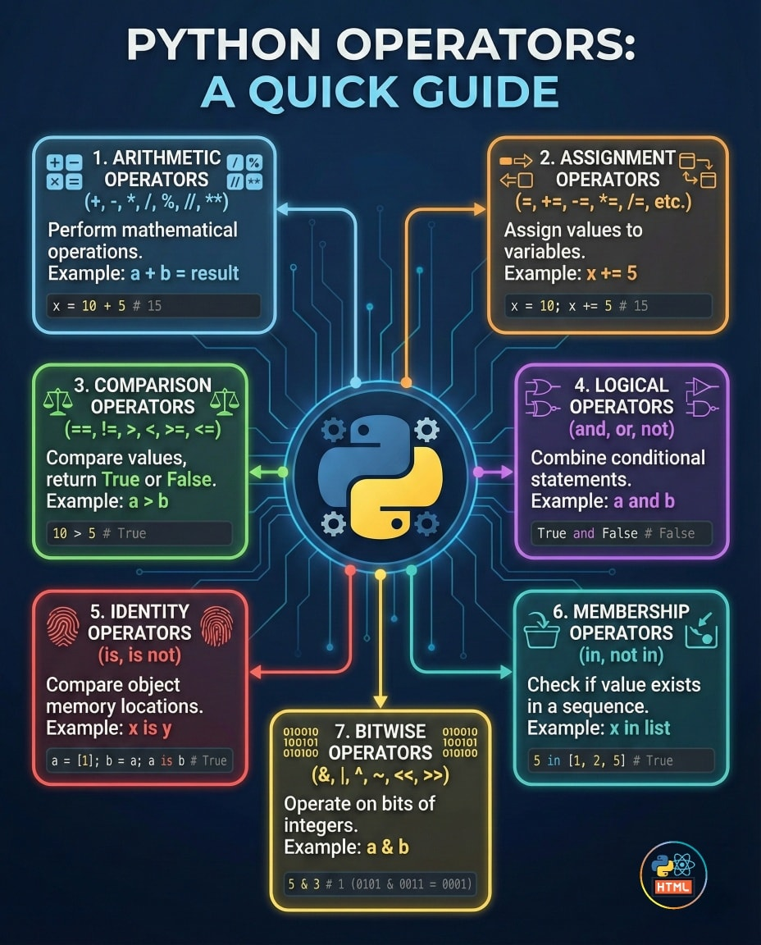
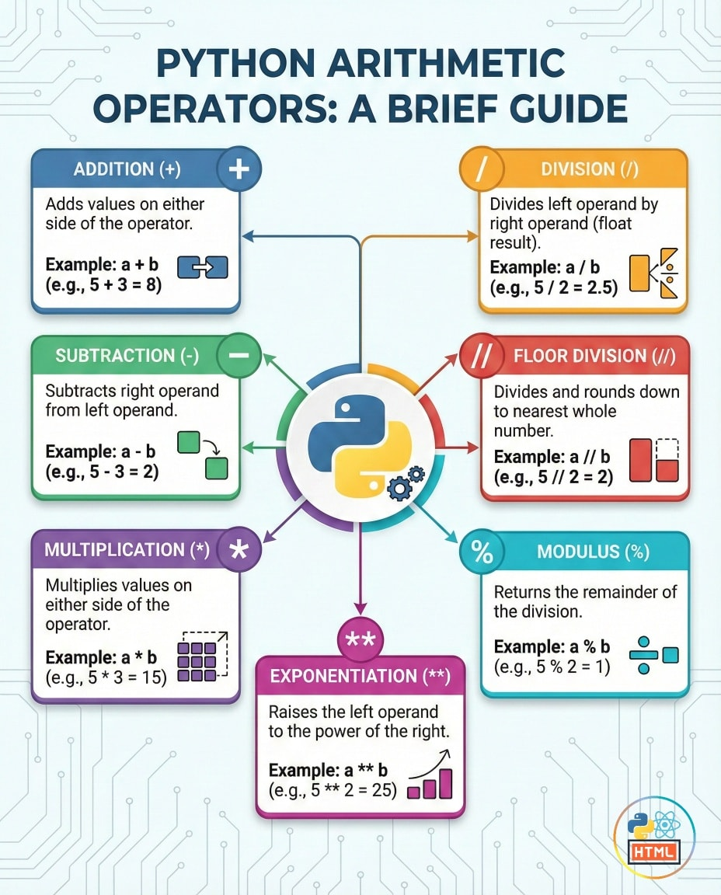

Slide 32
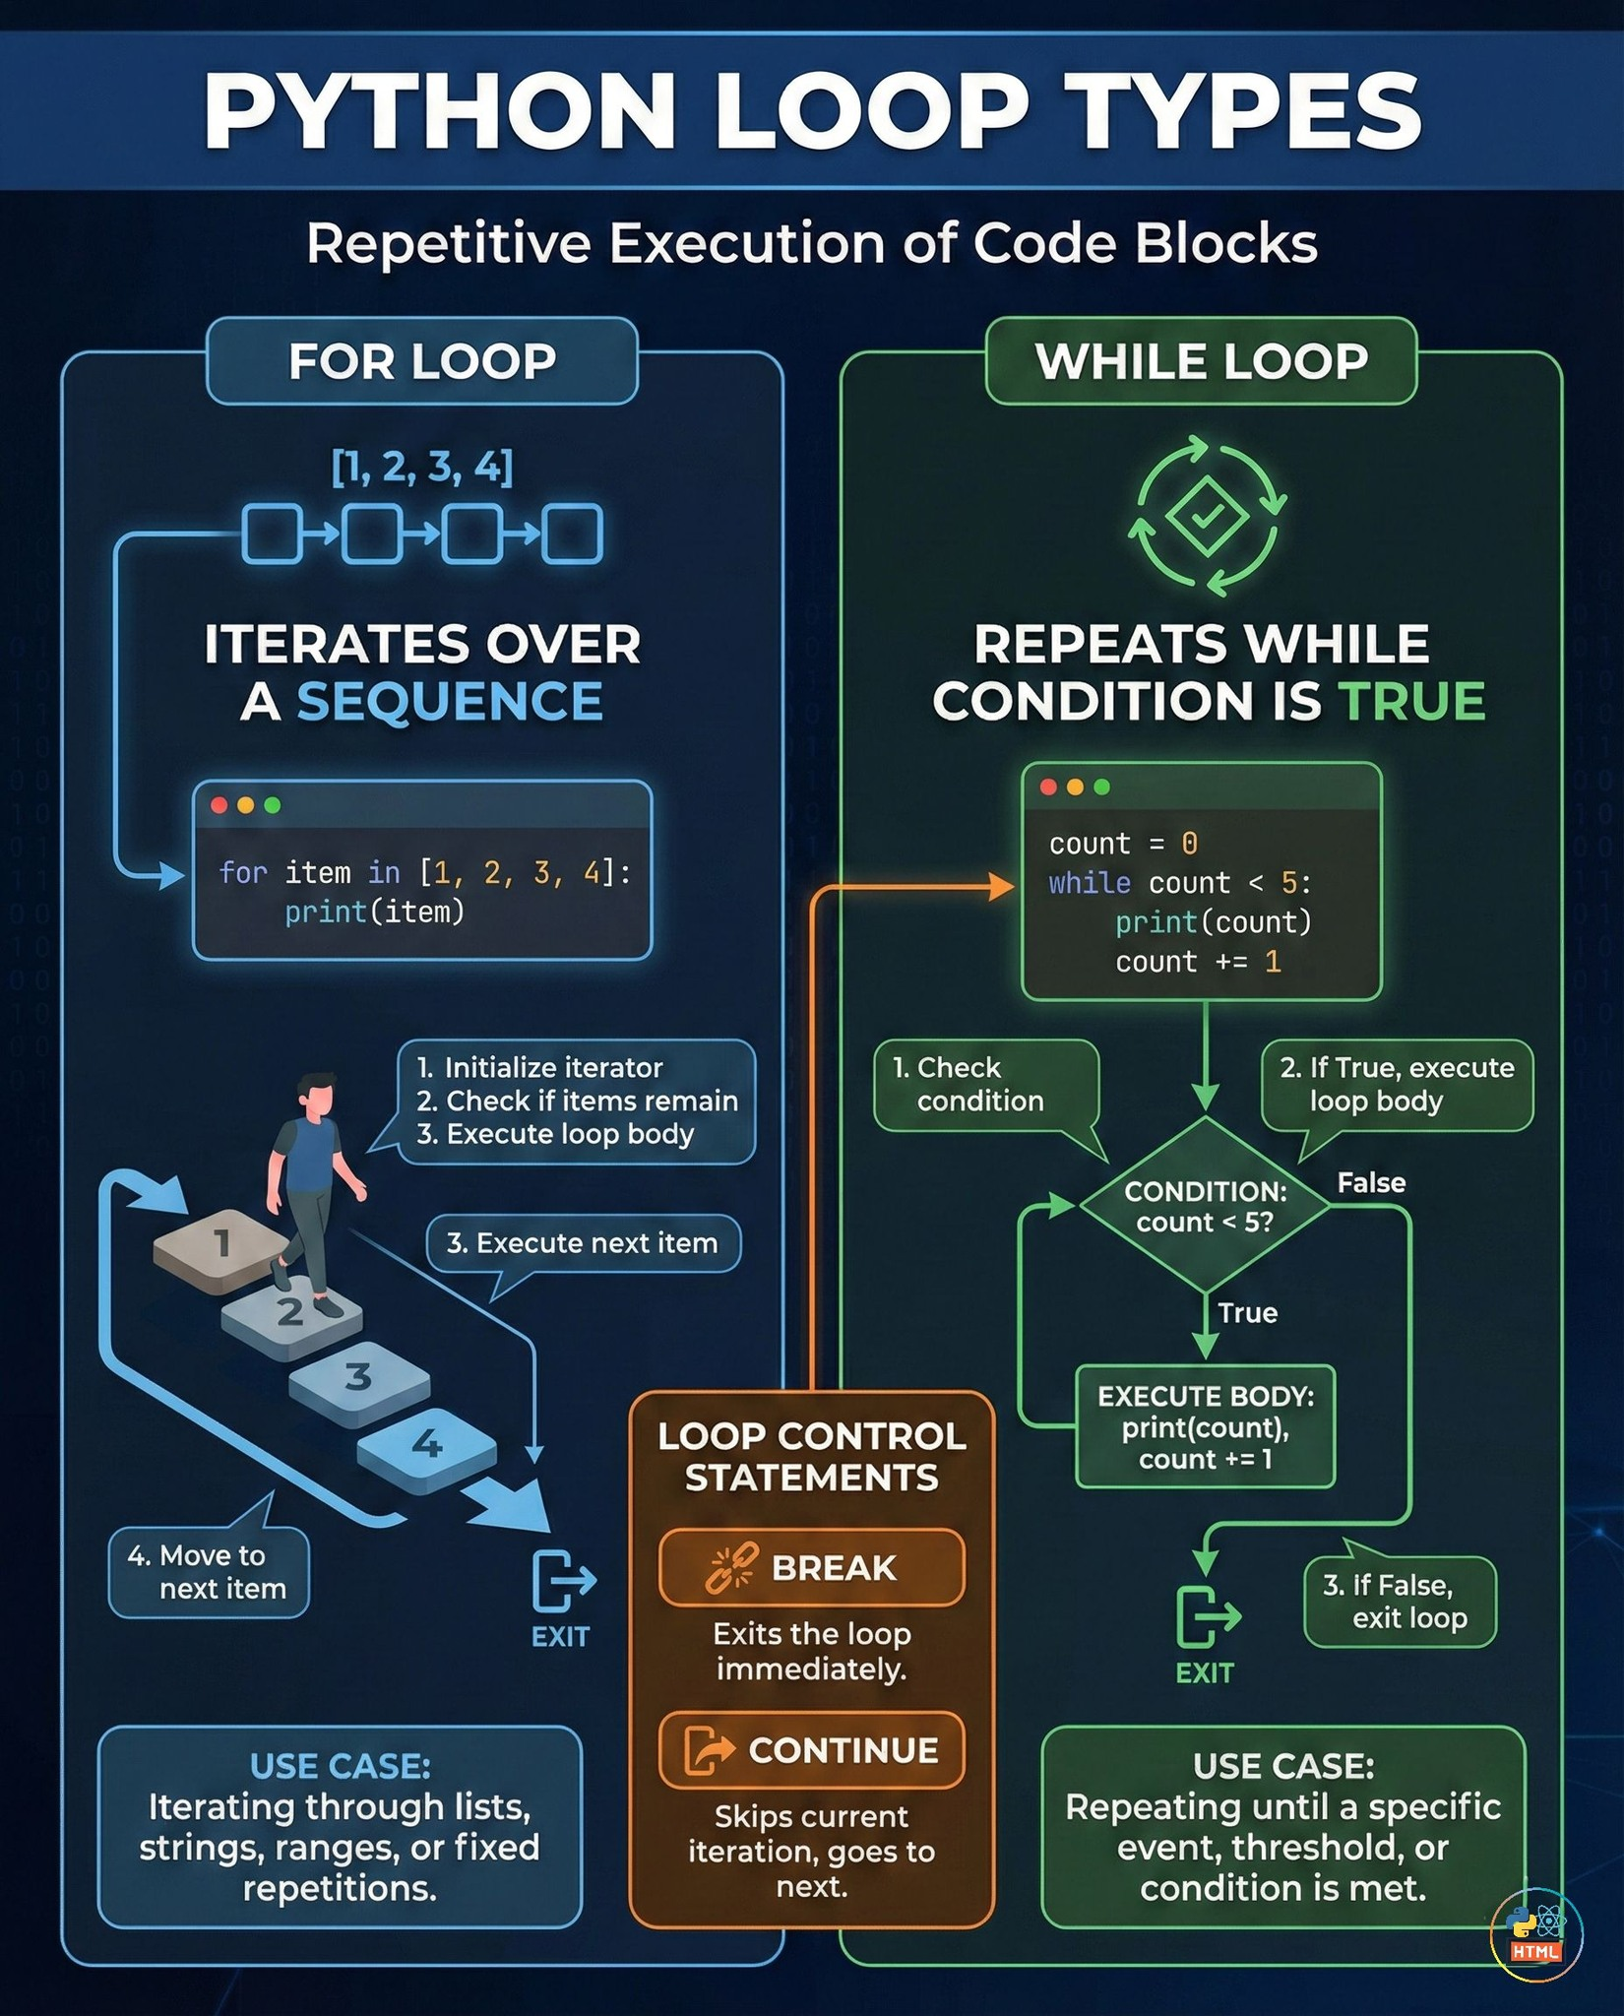

Slide 34
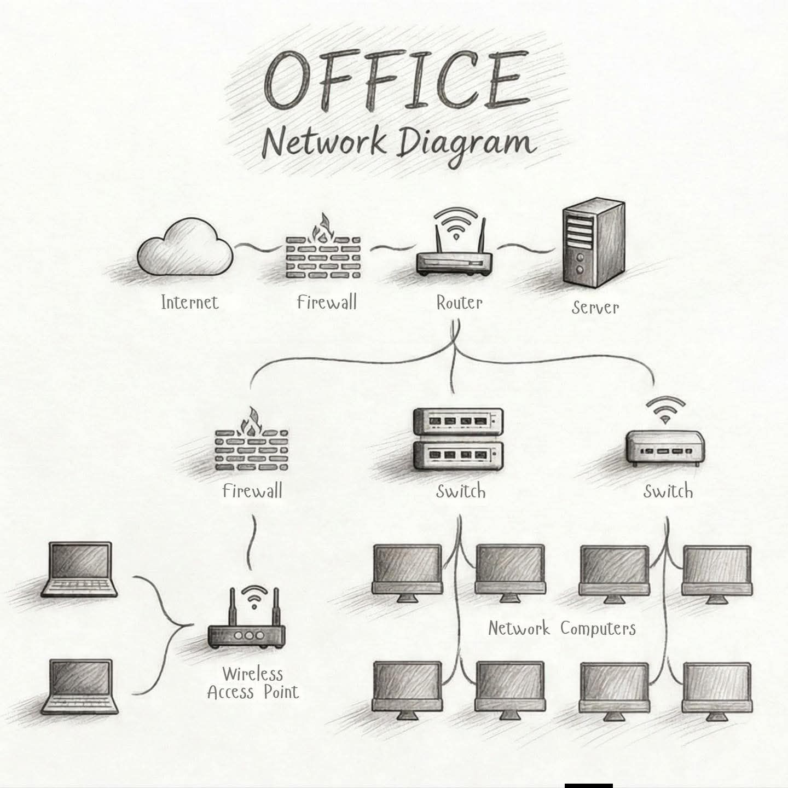

Slide 35
